Slide 1
Everything You Wanted to Know About Pregnancy ~ from A to Z

Slide 2
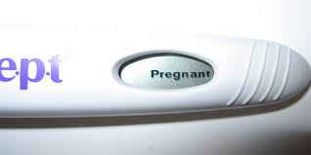
Adjusting to the News
It is common for families to respond to any life changing event, whether job loss, death or teen pregnancy, by going through the following stages of grief.
Denial – feeling shock and numbness
“This can’t be true.”
Anger – striking out, blaming, resentment.
“This is not fair.”
Bargaining – Hoping it’s not true
“Let’s take another test.”
Depression – sadness, emptiness, self-pity
“My life will never be the same.”
Acceptance – dealing with it, sense of calm
“Everything will be okay.”
Remember, each person goes through these stages at his or her own pace. Allow time to experience thoughts and feelings. Confide is a trusted person. Crying offers relief.
weteachfacs.com

Slide 3
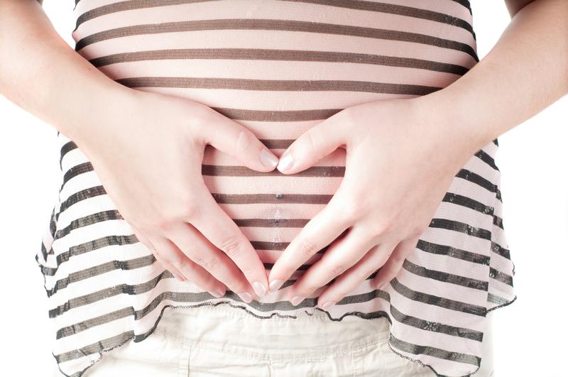
Bonding with your Baby
Interacting with your baby will directly affect his growth and development. It will release endorphins in you that will make you feel happy and calm.
Begin talking to your baby
Read to your baby
Ask him how he’s doing today.
Stroke and pat your tummy.
Play with him by poking your tummy
Sing to him
Listen to soft music
Dance with him
Tell him you love him and you can’t wait to hold him.
weteachfacs.com

Slide 4
Community Resources
Search the phonebook or online with keyword: social service agencies, your town. Search the internet about topics that concern you.
Pregnancy centers provide pregnancy tests, counseling, prenatal and parenting classes, baby furniture and much more.
Health departments provide prenatal clinics, immunizations and nutrition programs (WIC).
Department of Health & Human Services administer all public assistance programs including paternity testing, child care, Healthy Start, food card and employment resources.
Religious organizations offer support by providing child care, housing, food, baby items and more.
Your local public library provides resources and information services about any topic imaginable.
weteachfacs.com

Slide 5
Danger Signs
Call your doctor immediately if you experience any of the following:
Swelling of face and hands could be a sign of preeclampsia or hypertension
Vaginal bleeding could be a sign of miscarriage or placenta previa
Fever could be a sign of an infection.
Abdominal pain could be a sign of premature labor.
Unusually thirst and frequent urination could be a sign of gestational diabetes
Headache could be a sign of high blood pressure.
Vision problems could be a sign of preeclampsia.
Gush or trickle of fluid from vagina could be a sign of premature rupture of the membrane (amniotic sac).
weteachfacs.com

Slide 6
Eat Healthy
Baby needs calories and nutrients to build heart, lungs, brain and skeleton.
You are not eating for two, but you are sharing what you normally eat with your baby.
Make time for breakfast.
Avoid snacks with no nutrients; soda, coffee, chips, cakes and cookies.
Avoid fruit juice loaded with sugar. Eat fresh fruit instead.
Eat smaller portions several times per day.
Good choices at fast food restaurants include:
Grilled chicken, not fried
Baked potato, not French fries
Salad or fruit, not cookies
Milk or low fat yogurt, not milk shakes
weteachfacs.com

Slide 7
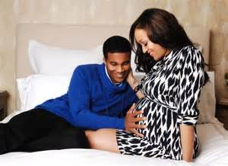
Fathers are Important
Fathers may be having many feelings during pregnancy too.
Sense of pride
Feeling jealous or left out
Having sympathy pains
Sense of mortality
Fear and worry
Guilt for the pregnancy
Involve his family because they are becoming grandparents too.
He can make sure you are taking care of yourself by:
Taking you to doctor visits
Making sure you are eating healthy
Encouraging exercise by going on walks
Encouraging you to relax and rest
Keeping alcohol, cigarettes and drugs away from you and baby
weteachfacs.com

Slide 8
Get Your Education
One of the biggest fears may be what others will think of you. Try to think about what you will say when people start asking questions. They will stop talking and admire you when they see that you are confident and not ashamed.
Be sure to seek help from your administrators, guidance counselors and school nurse. They will need to know why you may be feeling ill and going to the restroom often. Confide in your teachers because they will be concerned about you and your baby.
Pregnancy is not an illness and should not be a reason to stay home from school unless your doctor has identified you as high risk. Nausea and fatigue may overwhelm you in the beginning but try to work through it and soon it will pass.
weteachfacs.com

Slide 9
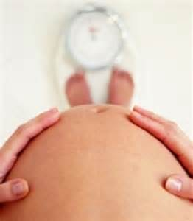
Healthy Weight Gain
Gaining just the right amount of weight depends on many factors. You can put your baby at risk if you gain too little or too much weight. As a teenager your body is still growing so it’s vital that you are eating enough calories and nutrients for your development as well as your baby’s.
During pregnancy women generally only need an additional 300 calories added to their daily intake.
Talk to your health care provider about how much weight gain is appropriate for you. It will be based on your overall health and your pre-pregnancy weight.
If you’re rapidly gaining weight talk to your health care provider. Gaining more than 2 pounds per week could be a sign of preeclampsia.
The weight you gain is not all baby. The weight is distributed all over your body. Your breast gain 2 lbs, maternal fat stores 7 lbs, extra blood and body fluid 8 lbs, placenta, amniotic fluid and uterus weighs 5.5 lbs and finally, the baby averages 7.5 lbs.
weteachfacs.com

Slide 10
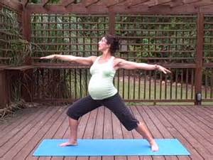
Invest Time in Yourself
Rest – because of the hormones you will feel very tired.
Take a warm (not hot) bath or shower.
Wear comfortable clothes. You won’t hurt the baby wearing something tight but you will be very uncomfortable.
See your dentist.
This would be a good time to learn a new hobby or craft. Ask a friend or relative to teach you so you can make something for your baby.
Do yoga or meditate in order to bring total relaxation to your mind and body.
weteachfacs.com

Slide 11
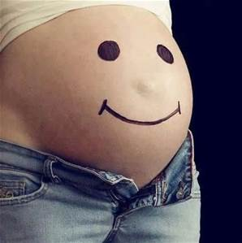
Just Think Positive
This should be a happy time in your life. You should have the same attitude toward your baby that you would have if you were older.
This is a miracle no matter what others may think of your situation.
This baby will be the most amazing person.
Be joyful!
Think of your beauty and glow. Be proud and be brave.
CELEBRATE!
weteachfacs.com

Slide 12
Keep a Journal
Get a blank notebook and take time to write about your pregnancy experience. Get to know yourself better by exploring how you feel about having a baby.
Write about daily events, what happened at school, with your family, your partner, your prenatal visits.
Here is a list of other topics you can write about:
Who was the first person you told?
How did your family react to the news?
How has your relationship changed?
What foods are you craving?
What are your plans for the future?
When did you feel the first kick or hiccup?
What is your most comfortable sleeping position?
When is your baby most active?
What is the best and worst part of pregnancy?
How do you feel about labor?
Describe a dream you had.
Write a letter to your baby.
weteachfacs.com

Slide 13
Learn about Childbirth
Every woman has a unique childbirth experience so keep that in mind when stories are shared. Try not to let these conversations scare you.
Remember, the more you know, the more confident you will feel during childbirth. Begin researching all aspects of childbirth.
Register early for childbirth classes so you have plenty of time to learn everything before the big day.
Some of the topics that you need to know:
False labor vs true labor
The process of labor and delivery
The role of your delivery coach
Comfort techniques
Medications available
Medical procedures
weteachfacs.com

Slide 14
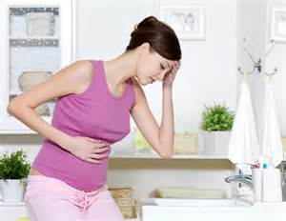
Minor Discomforts
You might be constipated or get hemorrhoids because your bowels will function more slowly.
You might have a backache because your spine is supporting the weight of the uterus.
You might have breast tenderness because the milk glands are enlarging.
You will have to urinate frequently because the uterus is pressing on your bladder.
You might get sharp abdominal pain when the ligaments around the uterus are stretched.
You might have nasal stuffiness because the lining in your nose will swell.
Your ribs might hurt because they are expanding as the baby grows and moves upward.
weteachfacs.com

Slide 15
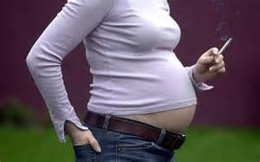
Never Do Drugs or Smoke
Avoid all substances including over-the-counter medications and street drugs.
Your baby will receive everything you ingest. Your body will be able to process the substance but the baby’s liver is too immature to handle the poisons.
Your baby may end up with physical or intellectual problems that won’t show up for a few years.
You might prevent your child from being smart by consuming drugs and alcohol.
Avoid secondhand smoke
weteachfacs.com

Slide 16
Old Wives Tales
Tales, in general, have been passed down from generation to generation before information was recorded, published and read. Old wives tales explained things that people didn’t understand. Here are some examples:
Pregnant women should not take baths.
Pregnant women shouldn’t lift her hands over her head.
Heartburn means the baby has lots of hair.
More babies are born during full moon.
If you sleep too much labor will be harder.
A woman will lose a tooth for every baby she has.
If a pregnant woman drinks too much coffee the baby will have a brownish birthmark.
Pregnant women should eat for two.
weteachfacs.com

Slide 17
Plan for the Future
There is so much to think about now that you are having a baby. You must decide where to take childbirth classes, who will watch your baby when you go back to school, finding a pediatrician and getting your home ready for baby.
Don’t forget that the plans you dreamed of before the pregnancy are still possible and maybe even be more important now that you will be a parent.
This is a good time to think about what career you’d like to go into.
You can still go to college. With the support of your family everything is still possible.
Dream big!
weteachfacs.com

Slide 18
Quench your Thirst
Hydration is important for flushing waste products from your body, and aiding liver and kidney function in both you and baby.
You will need 8 to 12 eight ounce glasses of fluid. Fill a pitcher or large sports bottle and drink in small amounts throughout the day.
Avoid caffeinated and sweet beverages which can actually cause dehydration.
Dehydration can:
make you feel queasy
cause fatigue
cause toxemia
lead to miscarriage
cause preterm labor
be life threatening to baby and mother
weteachfacs.com

Slide 19
Rely on your Family
After your family adjusts to the news of your pregnancy they will be very supportive.
Go to them for guidance. You are still their child and they would still be as worried about you and your pregnancy even if you were 25 years old.
This is their grandbaby, the one they’ve always dreamed about having one day. When the baby is here they will love it and spoil it!
weteachfacs.com

Slide 20
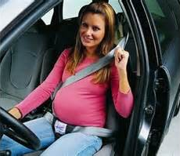
Safety for you and Baby
Wear your seatbelt throughout your pregnancy.
Avoid abusive relationships
Avoid inhaling cleaning chemicals. Use natural products to clean with; baking soda to scour the sinks, white vinegar and dish soap to clean the floor, windows and most other surfaces.
Avoid housing or building materials like paint and insulation.
Avoid sick people. Your immunity is down because of the physical demands during pregnancy. Try not to shake hands with people and wash your hands often. Sneeze into your arm. Get your flu shots.
Avoid a job that exposes you to dangerous chemicals, requires you to lift heavy objects, or stand for long periods of time.
Avoid the kitty litter and have someone else change it.
weteachfacs.com

Slide 21
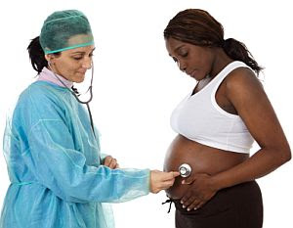
Tests During Pregnancy
Blood tests check for anemia, Rh factor, HIV
Glucose tolerance test – after patient drinks glucose solution blood samples are checked for diabetes.
Group B Strep Culture – screening for GBS bacteria.
Kick Counts – mother counts fetal movement for selected amount of time.
Non-stress Test – fetal monitor is connected to abdomen to check how baby’s heart rate responds to own movements.
Pap smear – cells are collected from cervix to check for STD’s and cervical cancer
Ultrasound – used to check the position of the baby, get the exact measurement of the baby to pinpoint due date, and to check healthy development of baby.
Urine Tests – check protein levels for diabetes or infections
weteachfacs.com

Slide 22
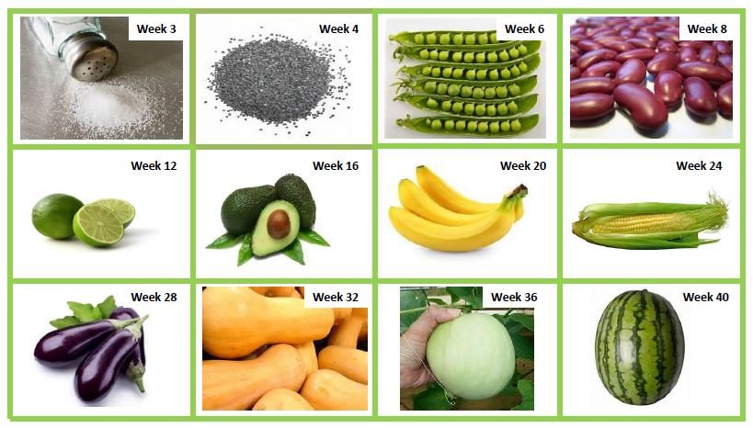
Understanding Development

Slide 23
Visit Your Provider
Your provider could include a family physician, OB/GYN, midwife or nurse practitioner.
At your first visit be as early as possible. There will be many things to complete as a new patient.
your medical history
check your urine
draw blood
check blood pressure
check weight
do complete physical (eyes, ears, nose, throat, heart, lungs)
breasts checked for lumps
Pelvic exam to check your cervix and the position of your uterus and ovaries.
Always write down the questions you want to ask at your appointment and write any comments or instructions the doctor gives you.
Remember to go to each appointment. Prenatal visits are vital for you and your baby. It’s important to have your pregnancy monitored to make sure all is going well.
weteachfacs.com

Slide 24
Write a Birth Plan
A birth plan is an outline to share with your medical team about the options you would like during the birth of your baby. Having a birth plan can put you more at ease once the unknown experience can be sorted out. Every birth is different but there are several events that can be considered after you have investigated labor and delivery practices. Search online for examples of birth plans.
Try to keep your plan to one page. You may want to include the following:
Names of the support team you will have
Religious or cultural practices
Environmental concerns (lighting, noise)
Preferred positions for labor
Preferred pain management
Preferred fetal monitoring
Preferred position for pushing
Preference regarding episiotomy
Feeding plans for newborn
weteachfacs.com

Slide 25
eXercise for You and Baby
Think of exercise as conditioning for a marathon. If you can build stamina and keep your muscles toned, your labor will be easier and you will recover faster.
Exercise is good for relieving stress and for your overall emotional well-being. It will help you sleep better and avoid constipation.
Exercise 3 times a week for 20 minutes. Don’t forget 10 minute warm up and cool down. Keep your heart rate under 140 beats per minute.
Most exercises and activities are still safe; walking, swimming, dancing, tennis, softball, bowling, golf and bike riding.
Avoid activities where you could get bumped or land on your stomach; basketball, volleyball, boxing, surfing, soccer, water or snow-skiing and ice or roller-skating.
Keep hydrated before, during and after workout.
weteachfacs.com

Slide 26
Your Changing Body
You will have some minor discomforts like bladder control problems, backaches, hemorrhoids, heartburn and tender breast.
Your skin will be stretched in various places besides you abdomen while the baby grows. Your breasts, hips, thighs and even your arms are enlarging and stretch marks can be found in these other areas. Your abdomen may itch from all of the stretching too.
Your hair will be affected my hormonal changes. You may notice thickness of your hair during pregnancy. But after the birth there may be a dramatic loss of hair, again, due to hormonal changes.
Cravings are thought to be the body’s way of letting you know it needs certain nutrients. For example if you are craving ice cream or other junk food, your body may need energy found in carbohydrates. Try to make nutritious choices and not give in to unhealthy cravings.
weteachfacs.com

Slide 27
Get Some Zzzzz’s
You will experience fatigue during the first and third trimester. Don’t ignore the urge to rest during the day. Your body is doing some pretty amazing things and needs the nap to rejuvenate.
If your nose is stuffy and you are coughing when you lay down try propping yourself up and sleep in a sitting position.
When your baby gets bigger your belly will need some support. Tuck a pillow under your tummy while lying on your side.
Some other helpful tips:
Avoid caffeine
Avoid TV and computer screens an hour before bed.
Read in bed
Make sure it’s not too hot in your bedroom
Avoid foods that will cause heartburn
Meditate with picture imagery.
weteachfacs.com

Slide 28
Slides by Christina Hickman, MA. Ed 2018

