Slide 1
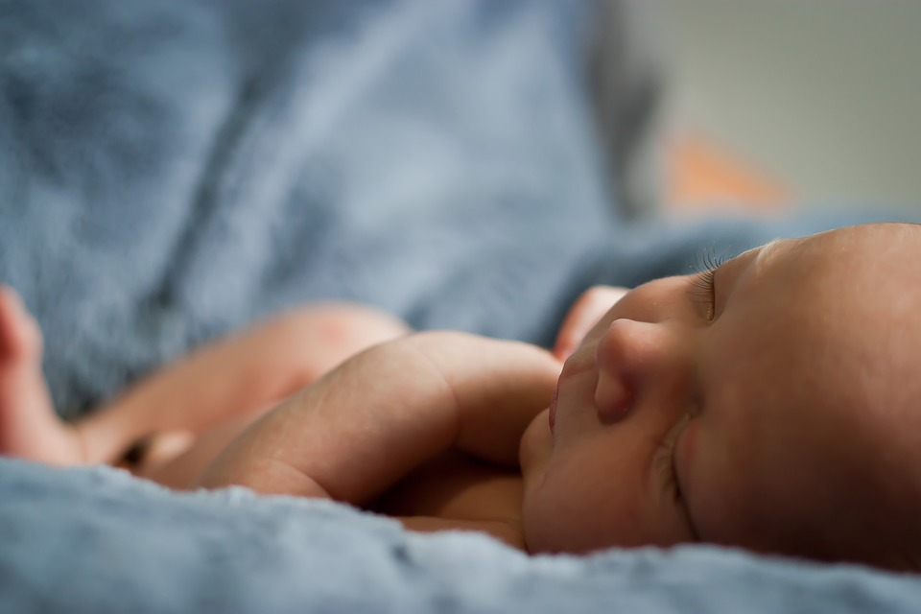
A Baby’s Brain

Slide 2
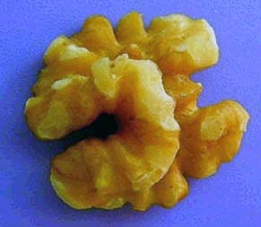
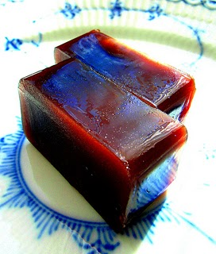
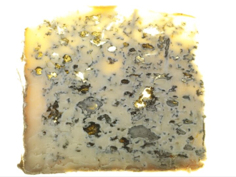
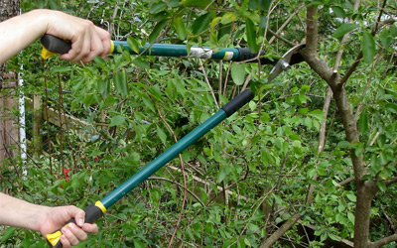
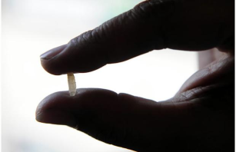
Ticket to Class What do the following have to do with the human brain?
Pinkish-Grey
Jello-Jigglers:
Pruning:
Walnut Half:
Blue Cheese:
Grain of Rice:

Slide 3
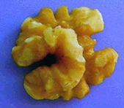
ANSWERS
Walnut Half: represents the wrinkled and convoluted surface of the brain.

Slide 4
ANSWERS
Blue Cheese: the brain smells like this.

Slide 5
ANSWERS
Grain of Rice: you can fit 10,000 neurons in it.

Slide 6
ANSWERS
Pinkish-Grey Jello-Jigglers: the brain is a pinkish-grey color and the consistency of jello-jigglers.

Slide 7
ANSWER
Pruning: neurons that don’t get used and make no connections, get “pruned”. This happens more rapidly in adolescence. The brain loses elasticity.

Slide 8
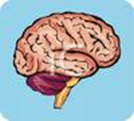
BRAIN TRIVIA
• Hardest working, vital organ in the body
• Represents less than 2% of body weight
• Uses 25% of oxygen you breathe
• Oblong shape
• Weighs approximately 3 pounds
• Takes up half the volume in your head
• Commander in chief of everything 24/7
• All trivia info from previous PPT slides
Created by Kim Graybill Child Development 2010

Slide 9
Created by Kim Graybill
Child Development
2010

Slide 10
True or False
What happens before birth does not affect learning.
The brain is completely developed at birth.
Brain development is completely genetic.
The bigger a newborn’s head the smarter the baby.
Brains get more active as they mature.

Slide 11
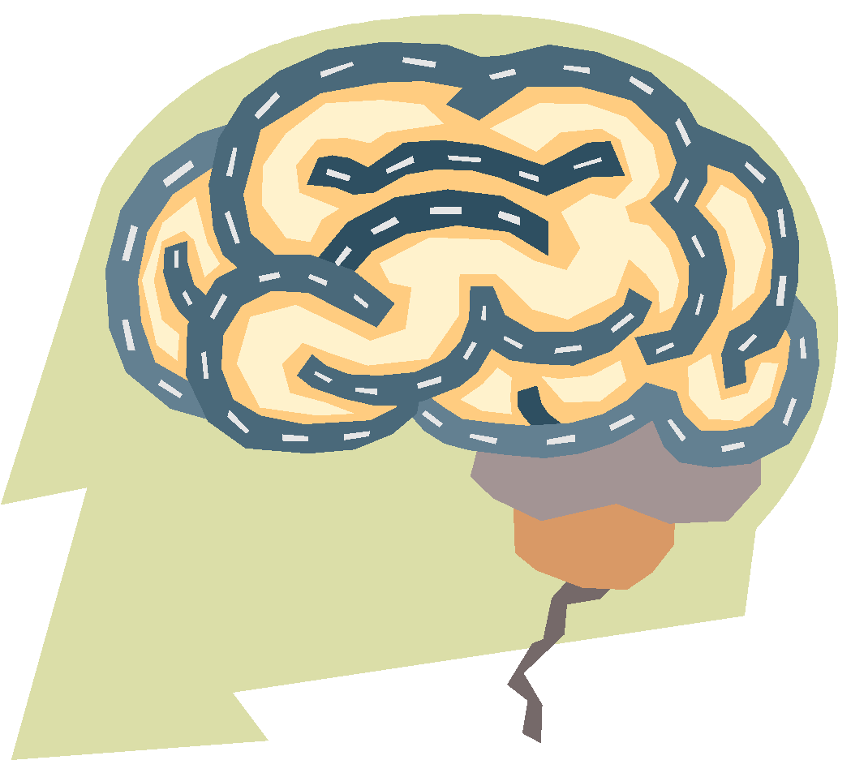
How Developed is a Baby’s Brain?
Not fully developed
Is the least developed organ
1/4th the size of an adult’s brain
By age 3, the brain has made trillions of connections among the brain cells.

Slide 12
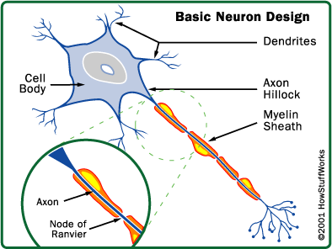
100 Billion Brain Cells
Each cell has 15,000 dendrites, small branches to which give off chemicals from an experience or stimulus.
The chemicals are looking for other dendrites with the same component.
These connections form pathways in the first three years of life.

Slide 13
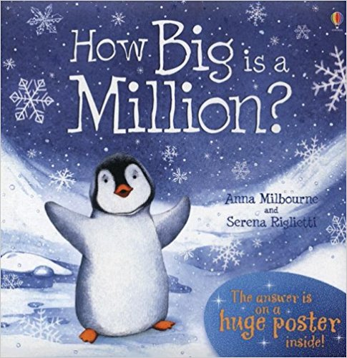
How Big is 100 Billion?
Referring to the story, how many posters would we need to equal 100 billion?
How many posters would each classmate need to equal 100 billion?

Slide 14
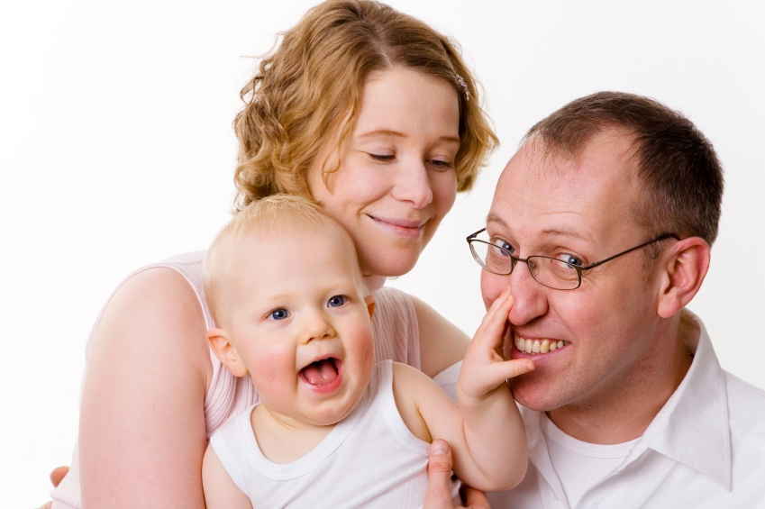
Synapse Connections
Are activated by the the five senses.
Sight
Sound
Smell
Touch
Taste

Slide 15
Stimulation
Any activity that arouses a baby’s sense of sight, sound, touch, taste, and smell.
Baby’s brain is in direct response to stimulation
Babies develop more quickly and have a more secure self-image
Living in a stimulating environment helps the child connect with what they see with what they feel, smell, and taste.
Repetition of actions reinforces pathways in the brain.

Slide 16
Mapping the 5 Senses
Here are 2 experiences, visiting a farm and going to the grocery store. I have color coded each of the senses that correspond with experience
Activity: List other experiences or places that would promote each sense.
Sight
Sound
Smell
Touch
Taste
Farm
Animals
Country air
Pet animals
Apple cider
Grocery store
Cash register
Bakery
Cans/boxes
Cookie

Slide 17
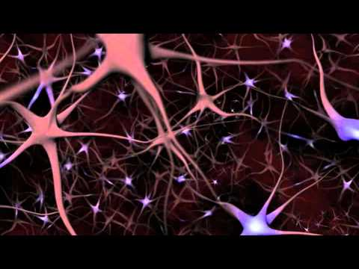
Neuron Connections
You Tube: Neurons and what they Do.

Slide 18
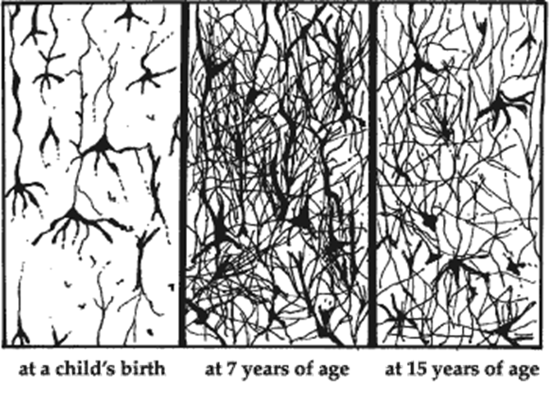
Synaptic Density
Infant’s mind is ready for learning but needs experiences.
By age 7 the brain has millions of connections, some of which were used only once.
In adolescence the brain prunes the connections that are no longer used or needed.

Slide 19
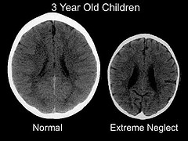
Neglect Affects Brain Growth

Slide 20
Answers = All False
What happens before birth does not affect learning.
The brain is completely developed at birth.
Brain development is completely genetic.
The bigger a newborn’s head the smarter the baby.
Brains get more active as they mature.

