Slide 1
Notes:
Class Discussion: How do babies learn to talk? Do you know any children that know sign language?

Slide 2
Notes:
Today we’re going to learn about language development and using sign language. Before we begin please read each statement and write the answer on your study guide.
Give students a moment.
How many believe they got all of the answers correct? Raise your hands. Ask a couple students to give their answers and compare. They will discover the correct answers during the presentation.

Slide 3
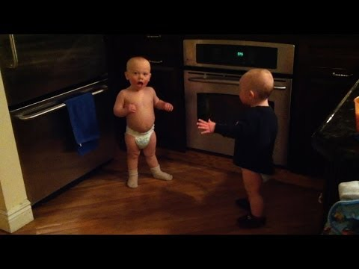
Video: Talking Twins
Notes:
Watch video.
The twins interaction shows examples of using intonation with conversational tones like
Questioning, pausing, responding and laughing.

Slide 4
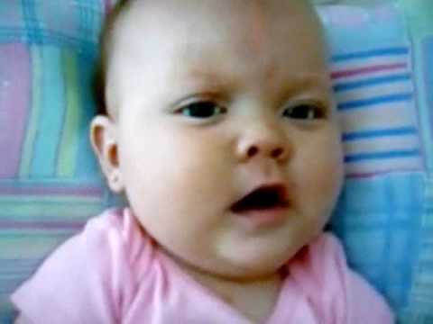
Video: Acquiring language

Slide 5
This page is blue.
Do you like the color blue? Lots of things in the world are blue. The sky. This page. Your sister’s eyes. Here’s a fun game. Let’s see how many blue things we can count around us.
When you talk to your child, you build vocabulary, so everyday moments become learning moments.
The United Way
Notes:
Activity: Think about all of the words you would use in an average day.
Now look at this slide. Pick out the words that are not in your everyday vocabulary. How many did you find?
If you talk to your child he will gain an even larger vocabulary!

Slide 6
Notes:
How could you talk about other letters in the alphabet?

Slide 7
Notes:
According to the researchers at Rice and Columbia Universities children from middle-class and affluent homes hear 30 million more words in the first three years of life than poor children hear. The number of words a child hears each day influences his future intelligence.
Brainstorm why this is happens in low income families.

Slide 8
Notes:
Why would reading this book to a child be beneficial?

Slide 9
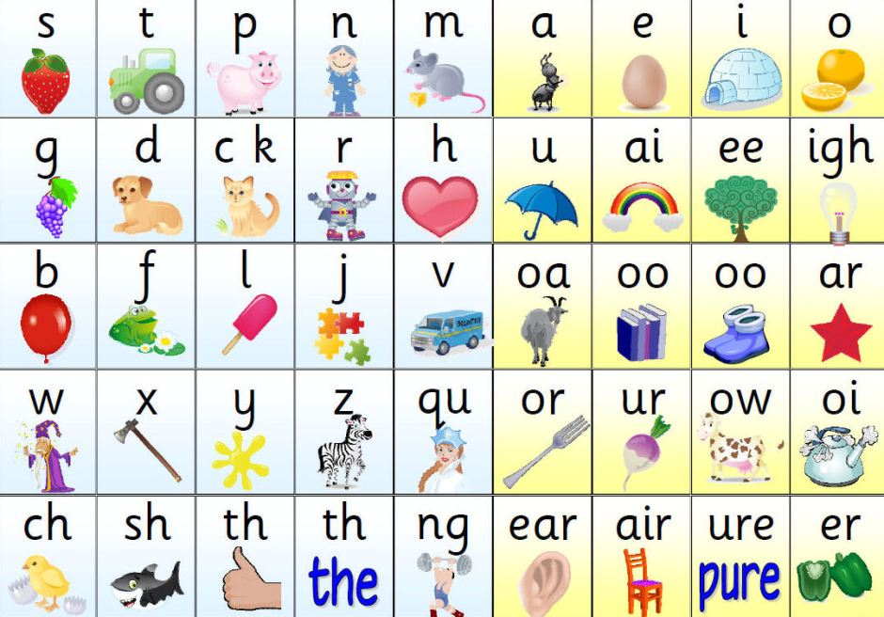

Slide 10
Notes:
Infants can understand language shortly after birth. But they can’t speak until they are between 12 – 24 months.
However, your baby has the ability to learn sign language by 6 months.

Slide 11
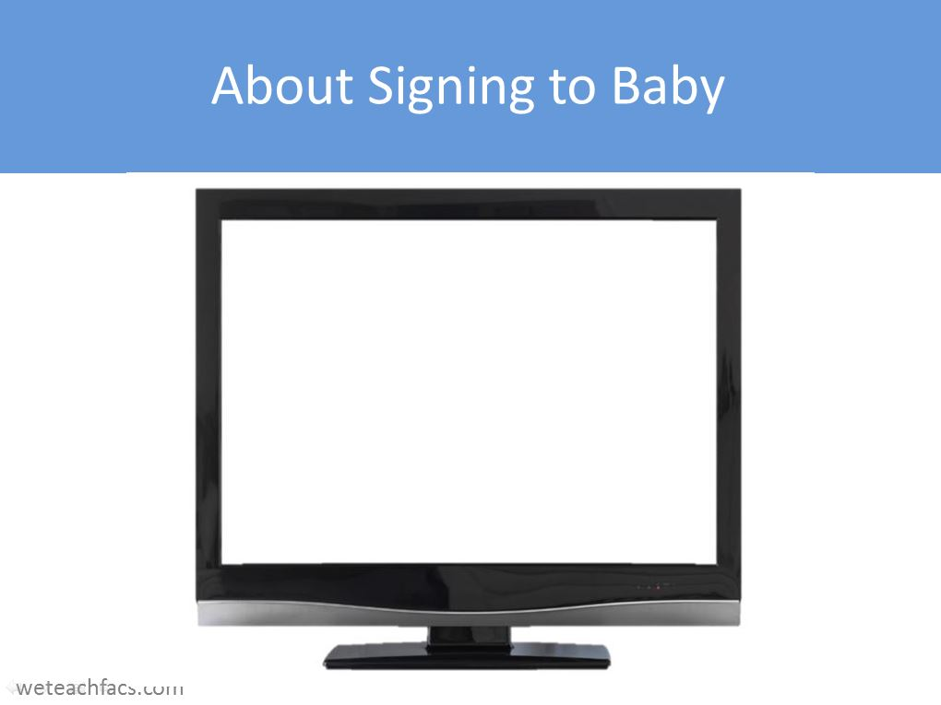
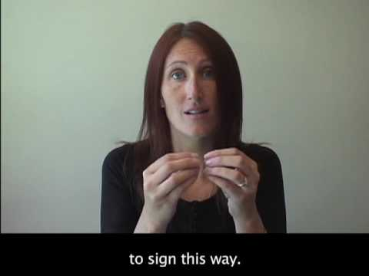
Video: Baby Sign Language

Slide 12
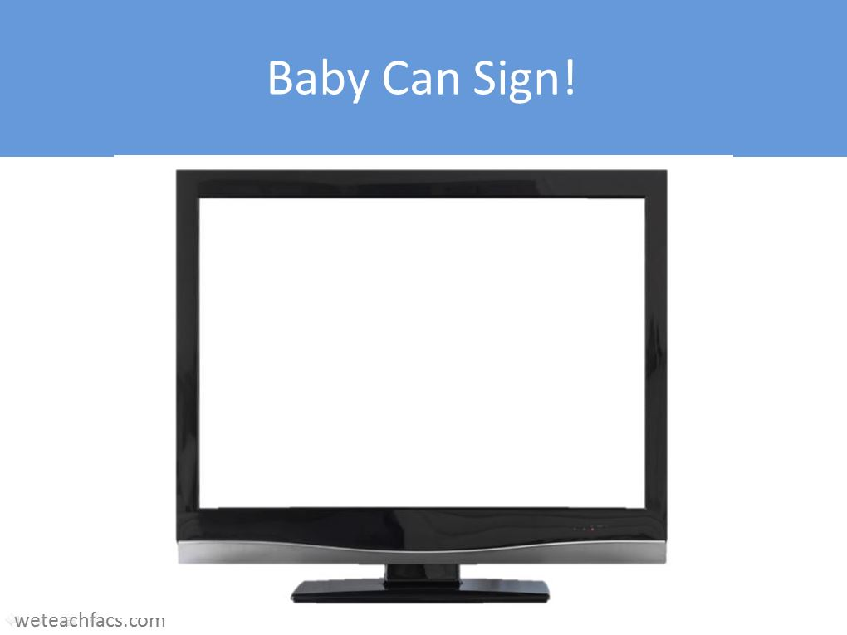
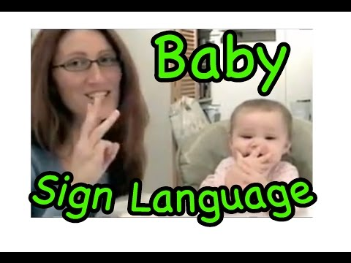
Video: Baby Can Sign

Slide 13
Notes:
This is a suggestion for teaching the word “more”.

Slide 14
Notes:
How would you teach the sign for “eat”?

Slide 16
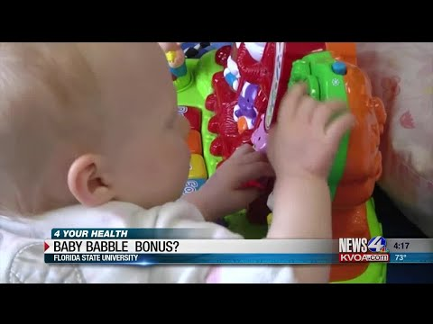
Vdeo:
Baby Babble

