Slide 1
A typical teenage diet

Slide 2
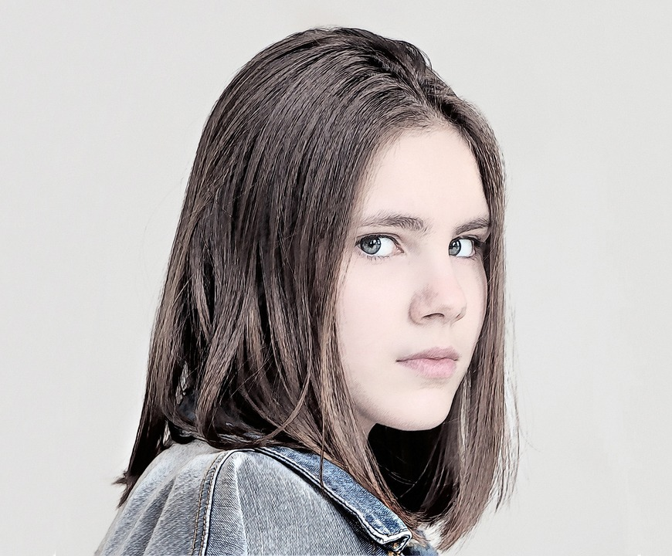
Hello!
This is Aleena

Slide 3
Aleena doesn’t have time for breakfast
So. she has a quick cup of coffee and leaves for school.

Slide 4
By mid morning she’s hangry so she has a fruit drink and a candy bar

Slide 5
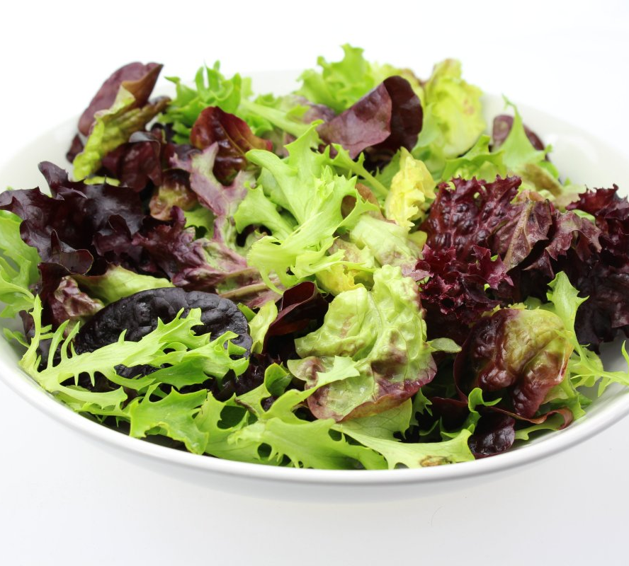
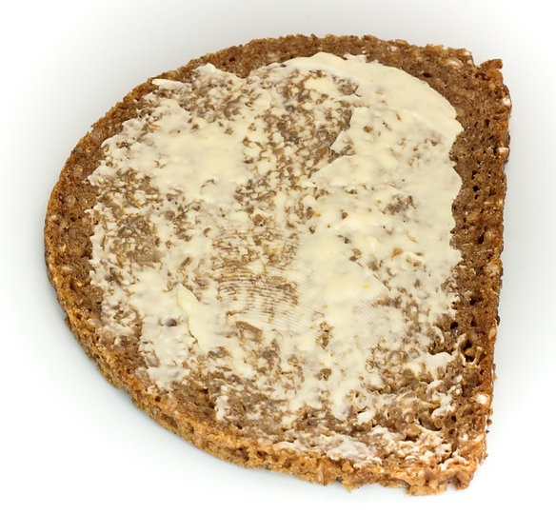
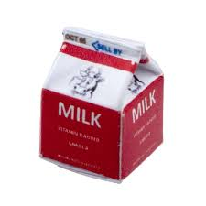
Lunch in the school cafeteria

Slide 6
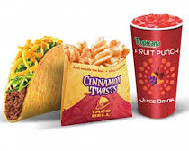
I’m starving! Going to
taco bell
After School

Slide 7
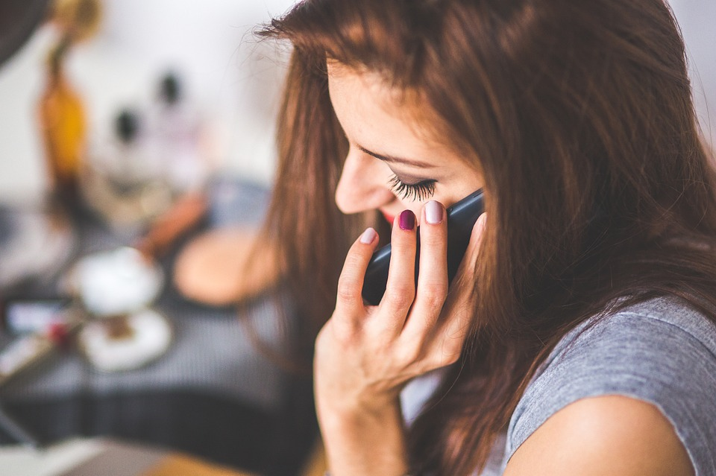
on her cell until mom comes home

Slide 8
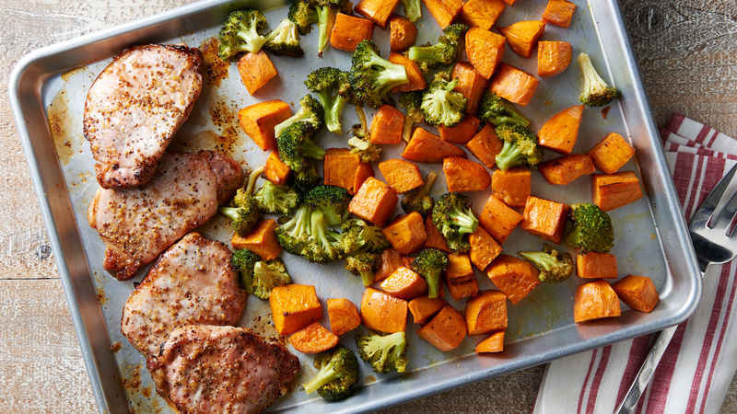
Mom makes a healthy dinner

Slide 9
Then she had a big piece of cake

Slide 10
Before
bed
She did her homework while watching TV with a soda and popcorn.

Slide 11
Aleena is 5 months pregnant!

Slide 12
How is aleena doing

Slide 13
Christina hickman, MA Ed 2018

