Slide 1
Budgeting for Baby

Slide 2
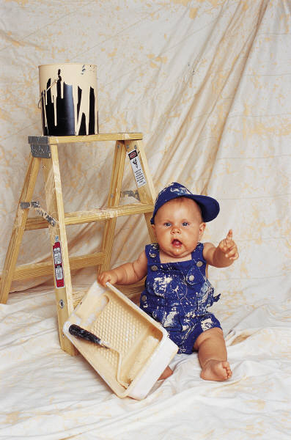
Slide Sections and Activities
Budgeting for Baby Study Guide
Analyze Annual Expenditures

Slide 3
Children Are Priceless
Children are priceless, but raising them is probably the most expensive things you’ll ever do. Here are some breakdowns on where the expenses may be found.

Slide 4
You are worth a Quarter of a Million
Over the child's first 18 years of age, the cost is currently estimated to
add up to $241,080.
Let’s break down the costs!

Slide 5
Diapers
If you use disposable diapers, plan on spending between $2,000-$3,300
by the time your baby is potty-trained.
Cloth diapering can be just as expensive as disposables if you use a diaper service.
If you launder them yourself, you can save money.
It is estimated that cloth diapering costs approximately $800-$1,100 by the time your baby is potty-trained (without the diaper service.)

Slide 6
Baby Arrival
Average bill for doctors’ fees and hospital
charges - $9,700
For C-Section - $12,500
Complications – up to $300,000
If you are covered by insurance,
it may cover most of the cost.

Slide 7
Saving
The total of all these
costs by the time a child graduates from college add up to a lot of money!
That's why any expecting parents should begin budgeting and saving today!
The total of all these costs by the time a child graduates from college add up to...A lot!
That's why any expecting
parents should begin budgeting
and saving today!

Slide 8
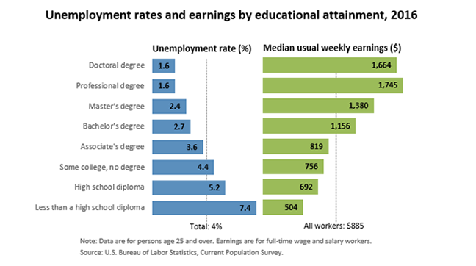
Earnings by Education Attainment, 2016

Slide 9
Baby’s First Year
According to a 2015 USDA report,
the average middle-income family will spend
roughly $12,680 on child-related expenses in
their baby’s first year
These amounts break down as follows:

Slide 10
Feeding Baby
Formula (up until your baby is one-year-old), will most likely cost between $1,000-$2,300.
Plan to spend at least $40 a week on infant formula.
Babies eat every 2 – 3 hours in the first couple months.
You can cut your costs dramatically
by breastfeeding for a year or more.

Slide 11
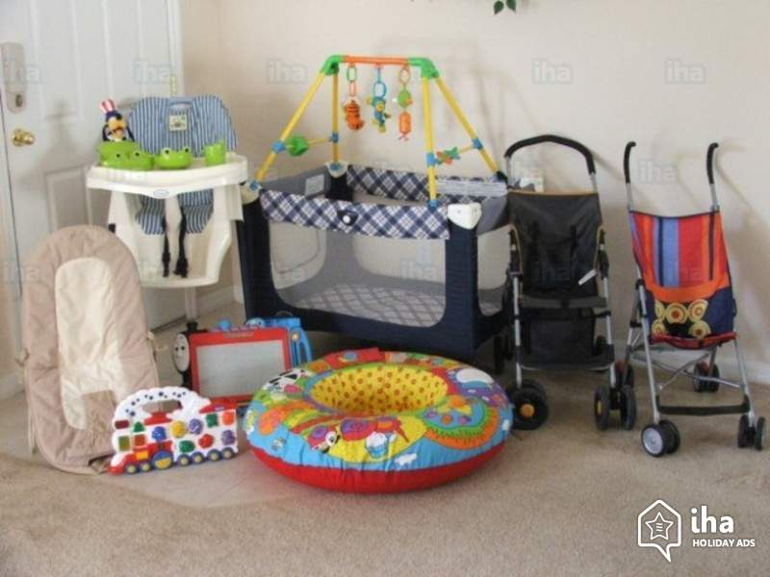
New Baby “Stuff”
Baby Furniture/Bedding $400
Stroller $100
Car Seat $100
High Chair $75
Diaper Bag $50
Baby Monitors $50

Slide 12
Costs for 1 year of child’s life
Housing………………...$3160 - $5460
Food …………………….$1310 - $2210
Transportation…… $1200 - $2590
Clothing……………….. $670 - $1110
Healthcare………….. $820 - $1580
Childcare……………... $2080 - $5170
Miscellaneous………. $450 - $1650

Slide 13
Housing
This is the biggest single expense of raising children, comprising anywhere from 33% to 37% of the overall annual expense.
Utility bills typically double when
a baby joins the family

Slide 14
Food $717.40 - $1097.30
2018 USDA Monthly Food Plans Family of 4:
Thrifty – Liberal
$717.70 - $1097.30
$5.98 - $9.14 per day
per family person

Slide 15
Transportation $1200-$2590
These costs are about 13% of your budget:
Car
Gasoline
Insurance
Car Seat $100-$200
Trike $50-$100
Bike $100-$200
Stroller -$50-$200

Slide 16
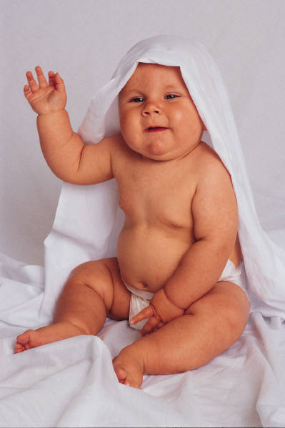
Clothing $670-$1110
7% of your budget
or about
$63 a month
Relatives become a main clothing provider
This cost has decreased over last 5 years

Slide 17
Healthcare $820-$1580
Doctor
Dental
Illness
Accidents
Disability
Co-Pays for Dr. Visits - $30
Co-Pays for ER Visits - $150

Slide 18
Childcare/Education $12,108
Day care: $2870 per month
Public/Private Education
Educational Toys and Books
Educational Lessons (piano, sports)
Piano $50 a month 12=$600
Sports Camp $1,000

Slide 19
Miscellaneous $700-$1700
Plan on about $50 a month
of unexpected costs.
Toys/Books
Computers
Sports Equipment
Hair care
Entertainment

Slide 20
College Costs
If the child goes to college, the costs continue to mount. Currently the costs are estimated to range from $4,000 to $80,000
over four years.
Public university tuition/fees $7,000 - $11,000 a year
Private university tuition/fees $31,000 - $44,000 a year
Public university room/board $6,872 a year
Private university room/board $5,565 a year

Slide 21
Ultimately, of course, nobody decides whether to
have a baby based purely on dollars and cents.
But monetary issues do play a role.

Slide 22
Estimating Annual Expenditures

Slide 23
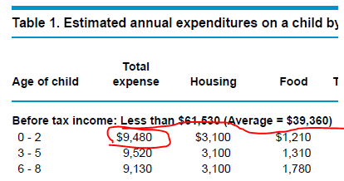
Estimated Annual Expenditures
Table 1. Two Parent
Underline the three income categories BEFORE TAX INCOME
Circle the total spent on the 0-2 year old in each of the three categories

Slide 24
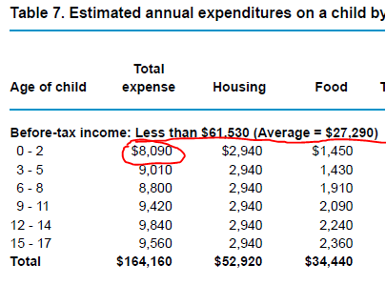
Estimated Annual Expenditures
Table 7. Single Parent
Underline the two income categories BEFORE TAX INCOME
Circle the total spent on the 0-2 year old in each of the two categories
What are the differences between the two tables

Slide 25
Factors Affecting Costs
Married, Single, Divorced
The cost of raising a child in a single parent
home are higher.
Reasons:
2 homes
Added transportation
additional child care for working parent.

Slide 26
Factors Affecting Costs
Education level attained
Income bracket (low/middle/upper)
Upper income families will spend 2 x the amount that a low income family will spend per child.
Number of children you have
Which part of the US you live, Urban/Rural

Slide 27
Christina Hickman, MA Edu, 2018

Slide 28
Life Status Activity
Part 1

Slide 29
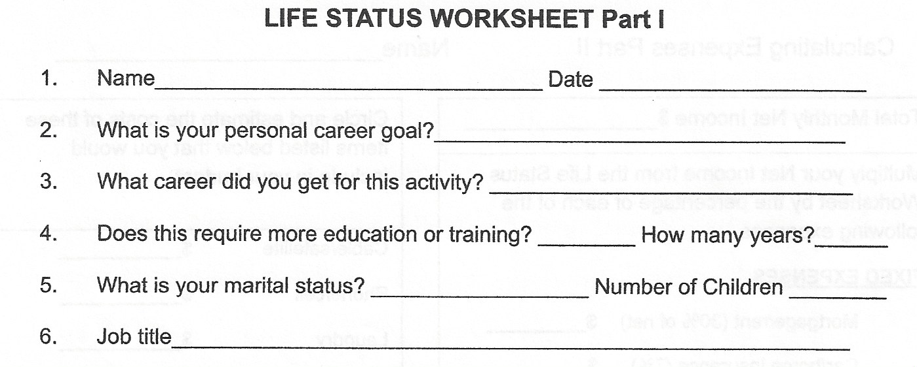
Life Status Worksheet
Pick a CAREER, SALARY, LIFE STATUS AND NUMBER OF CHILDREN and fill in the first section of this worksheet.
What did you end up with?

Slide 30
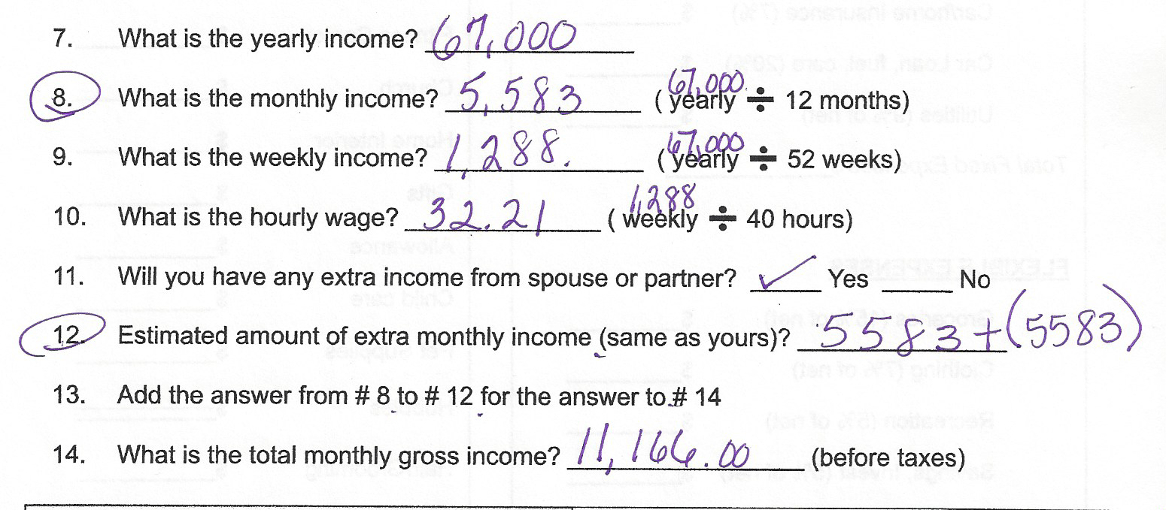
Life Status Worksheet cont’d

Slide 31
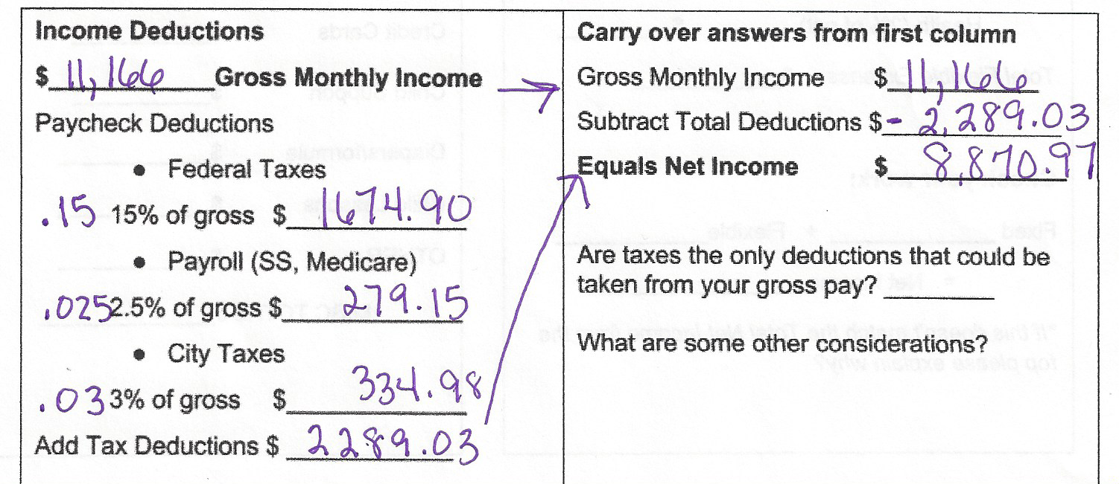
Life Status Worksheet cont’d

Slide 32
Calculating Expenses
Part 2

Slide 33
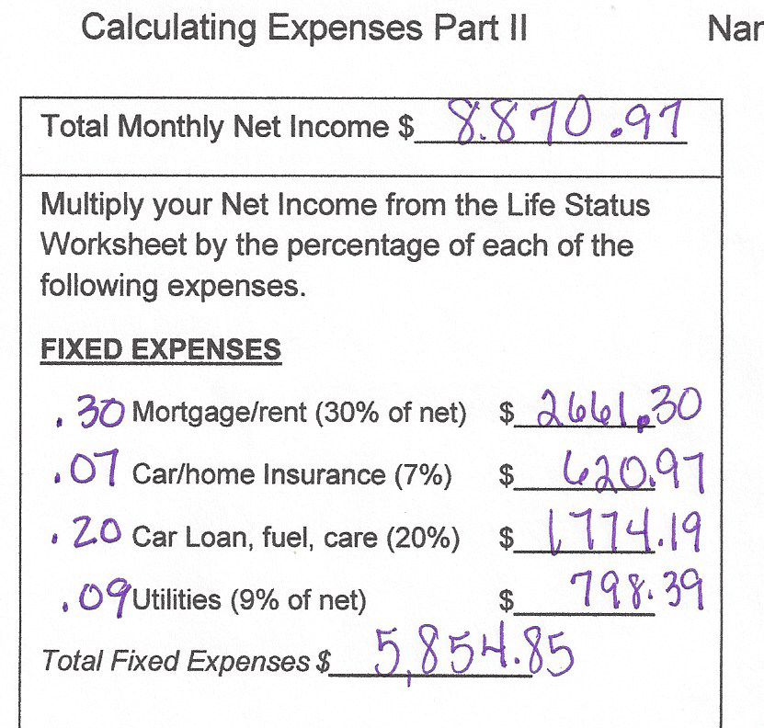
Calculating Expenses Cont’d
Net Monthly Income
x %* = Amount for Expense
*don’t forget to move the decimal two places to the left

Slide 34
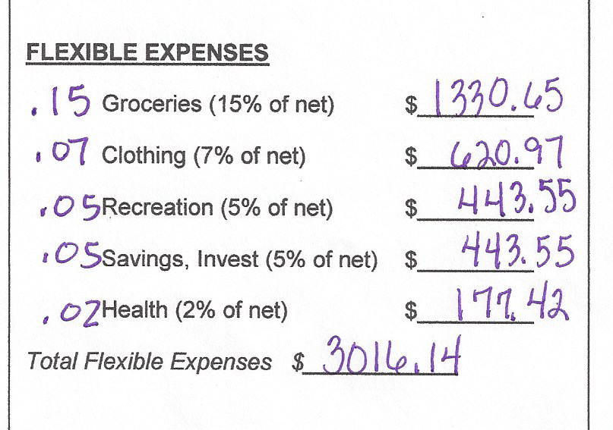
Calculating Expenses Cont’d
Net Monthly Income
x %* = Amount for Expense
*don’t forget to move the decimal two places to the left

Slide 35
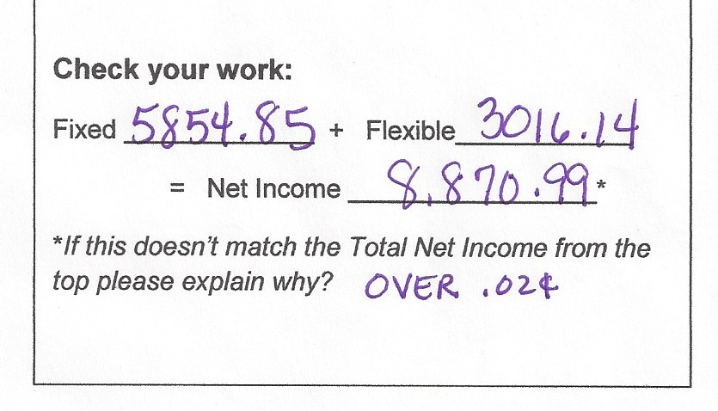
Calculating Expenses Cont’d

Slide 36
Calculating Expenses Cont’d
Look at your expenses. Are there items missing that you will need money for?
Do you have any money remaining on the left side on your paper?
%100 of your budget was spent on the standard fixed and flexible expenses.

Slide 37
Circle the items listed below that you would add you your budget. Search online for the average monthly costs. TOTAL
Cable/satellite $___________
Phone/cell $___________
Laundry $___________
Fitness Center $___________
Church $___________
Home Interior $___________
Gifts $___________
Allowance $___________
Child care $___________
Pet Supplies $___________
Hobbies $___________
Hair/Grooming $___________
Credit Cards $___________
Child Support $___________
Diapers/formula $___________
Child Lessons $___________
OTHER $___________
MISC TOTAL $______________

Slide 38
Calculating Expenses Cont’d
How much extra money do you need?
Go back to the top left of this worksheet and subtract the amount from your Month Net Income
Go back through and recalculate how much money you have for each Fixed and Flexible expense. Write the answer to the left of each expense.

