Slide 1
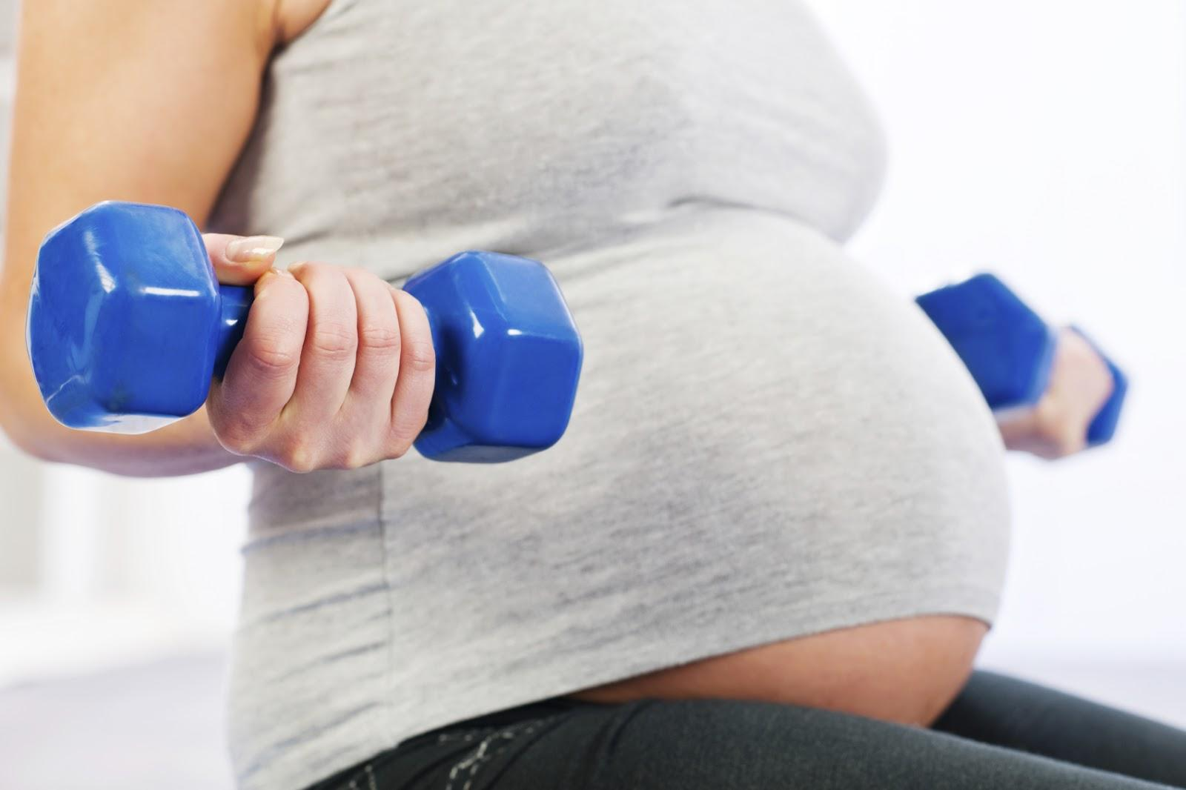
HEALTHY PREGNANCY

Slide 2
Month 1—1st Trimester
Missed Period
Fatigue
Excess saliva
Frequent urination

Slide 3
Month 2—1st Trimester
Breasts begin to swell and enlarge.
Possible morning sickness
Continued fatigue

Slide 4
Month 3—1st Trimester
Breasts continue to become fuller and ache
Morning sickness continues
Abdomen becomes larger
Uterus is about the size of an orange
Mood Swings
Increased appetite

Slide 5
Month 4—2nd Trimester
"Round ligament pain"
Start to feel better because morning sickness is usually gone
Not as tired
Starting to show, may have to buy maternity clothes
Red swollen gums during pregnancy
Nasal swelling
Cravings
Facial skin may darken

Slide 6
Month 5—2nd Trimester
Enlarged abdomen is obvious
Fetal heartbeat is heard
Quickening occurs
Abnormal Dreams
Leg cramps
Backache

Slide 7
Month 6—2nd Trimester
Fetal movement is strong
Kicking can be felt from the outside
sciatic nerve pain
Swelling legs and feet
Stretch marks
Heartburn

Slide 8
Month 7—3rd Trimester
Shortness of breath
Continued fatigue, leg cramps and frequent urination

Slide 9
Month 8—3rd Trimester
Fetal kicks are strong
Braxton Hicks
Difficulty sleeping

Slide 10
Month 9—3rd Trimester
Lightening
Easier to breath
Uterus is the size of a small watermelon
Breasts may leak
Nesting

Slide 11
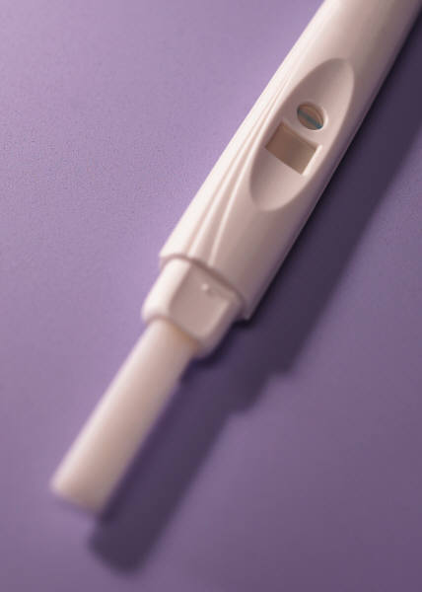
Early Signs Of Pregnancy
Signs occur within a few weeks of conception.
Missed menstrual period (often the first indicator)
Bloated, full feeling or mild ache in lower abdomen
Tiredness or faintness
A frequent, urgent need to urinate
Tender breast, causing discomfort or tenderness
Nausea or vomiting (usually in the morning)
If a woman believes she is pregnant, she should take a test as soon as possible.

Slide 12
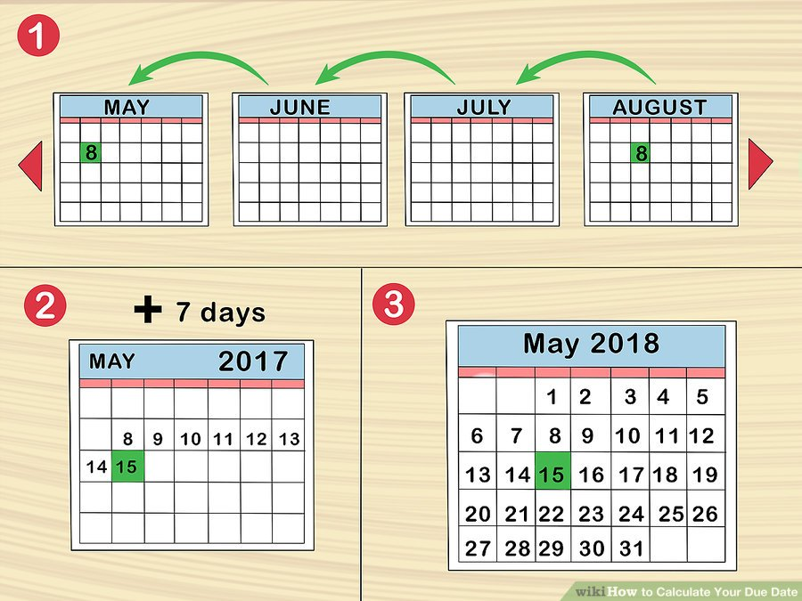
Calculating Due Date
First day of last period
Count back 3 months
Add one week
The baby can be born 2 weeks before or after expected date.
For example, if your last period began on August 8, then you could count back three months to May 8. If you add seven days, you'd get May 15. Your due date would then be next May 15.

Slide 13
Medical Care
Once pregnancy is determined, go to a health care provider.
Obstetrician- a doctor who specializes in pregnancy and childbirth.
1st Exam:
Check your health and medical history
Analyze urine for signs of infection or diabetes
Blood test for Anemia
A condition that results from not having enough red blood cells.
Symptoms: fatigue, shortness of breath, rapid heartbeat, and feeling cold and weak.

Slide 14
The First Exam
Rh Factor- certain protein
Determined genetically (done by a blood test)
If mother’s blood is Rh negative and fetus is Rh positive mom’s blood could produce proteins called Rh Antibodies.
Does not affect first pregnancy, but the antibodies can damage the next fetus’ red blood cells
Prevention- receive injection that will prevent the antibodies from forming.
Check woman’s immunity to rubella

Slide 15
Medical Care
Periodic checkups (prenatal visits)
1st to 6th month- once a month
7th to 8th month- twice a month
Final month- every week
24th to 28th week of pregnancy, most women take a glucose tolerance test to determine:
Gestational Diabetes- a form of diabetes that only occurs during pregnancy.
If left untreated, the baby will be heavier than normal.
Goes away after the baby is born
Can be controlled through a special diet and medication.

Slide 16
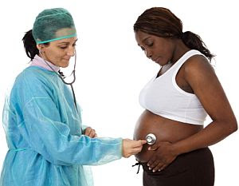
Tests During Pregnancy
Blood tests check for anemia, Rh factor, HIV
Glucose tolerance test – after patient drinks glucose solution blood samples are checked for diabetes.
Group B Strep Culture – screening for GBS bacteria.
Kick Counts – mother counts fetal movement for selected amount of time.
Non-stress Test – fetal monitor is connected to abdomen to check how baby’s heart rate responds to own movements.
Pap smear – cells are collected from cervix to check for STD’s and cervical cancer
Ultrasound – used to check the position of the baby, get the exact measurement of the baby to pinpoint due date, and to check healthy development of baby.
Urine Tests – check protein levels for diabetes or infections
weteachfacs.com

Slide 17
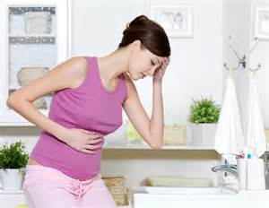
Minor Discomforts
You might be constipated or get hemorrhoids because your bowels will function more slowly.
You might have a backache because your spine is supporting the weight of the uterus.
You might have breast tenderness because the milk glands are enlarging.
You will have to urinate frequently because the uterus is pressing on your bladder.
You might get sharp abdominal pain when the ligaments around the uterus are stretched.
You might have nasal stuffiness because the lining in your nose will swell.
Your ribs might hurt because they are expanding as the baby grows and moves upward.
weteachfacs.com

Slide 18
Danger Signs
Call your doctor immediately if you experience any of the following:
Swelling of face and hands could be a sign of preeclampsia or hypertension
Vaginal bleeding could be a sign of miscarriage or placenta previa
Fever could be a sign of an infection.
Abdominal pain could be a sign of premature labor.
Unusually thirst and frequent urination could be a sign of gestational diabetes
Headache could be a sign of high blood pressure.
Vision problems could be a sign of preeclampsia.
Gush or trickle of fluid from vagina could be a sign of premature rupture of the membrane (amniotic sac).
weteachfacs.com

Slide 19
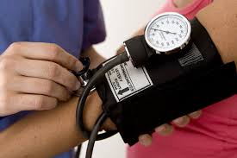
Preeclampsia
Another serious condition that occurs during the second half of pregnancy.
A condition characterized by high blood pressure and the presence of protein in the mother’s urine.
Prevents the baby from getting enough blood which provides oxygen and food.
Treatment- depends on how far along the pregnancy is.
Bed rest and medication

Slide 20
Quench your Thirst
Hydration is important for flushing waste products from your body, and aiding liver and kidney function in both you and baby.
You will need 8 to 12 eight ounce glasses of fluid. Fill a pitcher or large sports bottle and drink in small amounts throughout the day.
Avoid caffeinated and sweet beverages which can actually cause dehydration.
Dehydration can:
make you feel queasy
cause fatigue
cause toxemia
lead to miscarriage
cause preterm labor
be life threatening to baby and mother
weteachfacs.com

Slide 21
Safety for you and Baby
Wear your seatbelt throughout your pregnancy.
Avoid abusive relationships
Avoid inhaling cleaning chemicals. Use natural products to clean with; baking soda to scour the sinks, white vinegar and dish soap to clean the floor, windows and most other surfaces.
Avoid housing or building materials like paint and insulation.
Avoid sick people. Your immunity is down because of the physical demands during pregnancy. Try not to shake hands with people and wash your hands often. Sneeze into your arm. Get your flu shots.
Avoid a job that exposes you to dangerous chemicals, requires you to lift heavy objects, or stand for long periods of time.
Avoid the kitty litter and have someone else change it.
weteachfacs.com

Slide 22
Exercise for You and Baby
Think of exercise as conditioning for a marathon. If you can build stamina and keep your muscles toned, your labor will be easier and you will recover faster.
Exercise is good for relieving stress and for your overall emotional well-being. It will help you sleep better and avoid constipation.
Exercise 3 times a week for 20 minutes. Don’t forget 10 minute warm up and cool down. Keep your heart rate under 140 beats per minute.
Most exercises and activities are still safe; walking, swimming, dancing, tennis, softball, bowling, golf and bike riding.
Avoid activities where you could get bumped or land on your stomach; basketball, volleyball, boxing, surfing, soccer, water or snow-skiing and ice or roller-skating.
Keep hydrated before, during and after workout.
weteachfacs.com

Slide 23
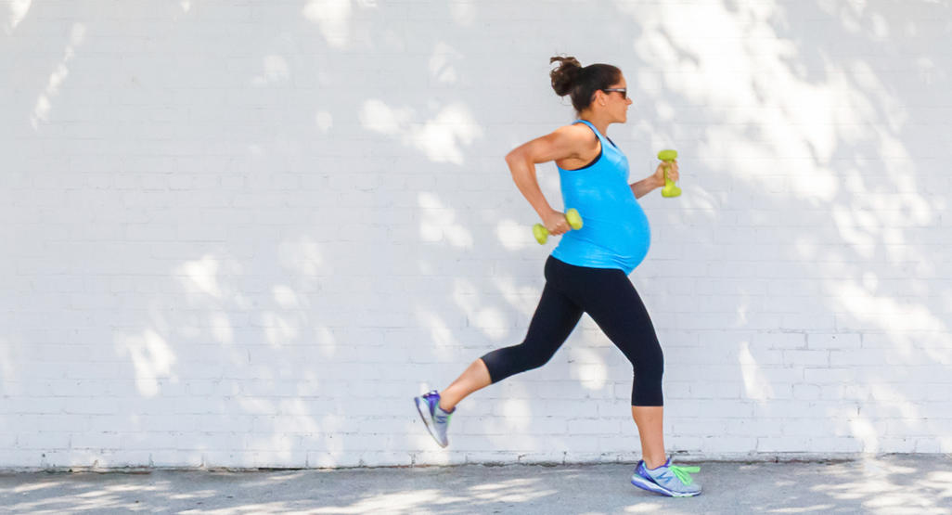
Exercise for You and Baby
Think of exercise as conditioning for a marathon. If you can build stamina and keep your muscles toned, your labor will be easier and you will recover faster.
weteachfacs.com

Slide 24
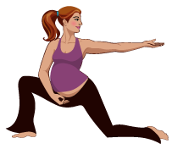
Benefits of Exercising
Mother
Improved cardiovascular function
Limited pregnancy weight gain
Decreased musculoskeletal discomfort
Reduced muscle cramps
Reduced lower limb swelling
Mood stability
Fetus
Decreased fat mass
Improved stress tolerance
Advanced neurobehavioral maturation
Notes:
Exercising has many benefits for both the mother and the fetus. For the mother it can improve cardiovascular function, limit pregnancy weight gain, decrease muscle and skeletal discomfort, reduce muscle cramps, reduce lower limb swelling, and stabilize mood. For the fetus studies have shown decreased body fat, improved stress tolerance, and advanced neurobehavioral maturation.
‹#›

Slide 25
Types of Exercise
Beginners
Walking
Cycling
Swimming
Aerobics
Exercisers
Running
Strength training
Notes:
‹#›

Slide 26
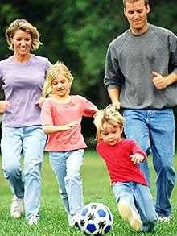
Exercises to Avoid
Downhill snow skiing
Contact sport
Football
Basketball
Ice Hockey
Soccer
Scuba Diving
Gymnastics
Horseback riding
Standing for long periods of time
Notes:
‹#›

Slide 27
Your Changing Body
You will have some minor discomforts like bladder control problems, backaches, hemorrhoids, heartburn and tender breast.
Your skin will be stretched in various places besides you abdomen while the baby grows. Your breasts, hips, thighs and even your arms are enlarging and stretch marks can be found in these other areas. Your abdomen may itch from all of the stretching too.
Your hair will be affected my hormonal changes. You may notice thickness of your hair during pregnancy. But after the birth there may be a dramatic loss of hair, again, due to hormonal changes.
Cravings are thought to be the body’s way of letting you know it needs certain nutrients. For example if you are craving ice cream or other junk food, your body may need energy found in carbohydrates. Try to make nutritious choices and not give in to unhealthy cravings.
weteachfacs.com

Slide 28
Health During Pregnancy
Steps to Manage Stress
Avoid sugary foods and caffeine
Exercise
Take a time-out
Practice relaxation techniques
Talk about concerns
Take a class for expectant parents

Slide 29
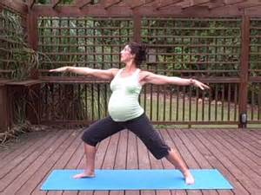
Invest Time in Yourself
Rest – because of the hormones you will feel very tired.
Take a warm (not hot) bath or shower.
Wear comfortable clothes. You won’t hurt the baby wearing something tight but you will be very uncomfortable.
See your dentist.
This would be a good time to learn a new hobby or craft. Ask a friend or relative to teach you so you can make something for your baby.
Do yoga or meditate in order to bring total relaxation to your mind and body.
weteachfacs.com

Slide 30
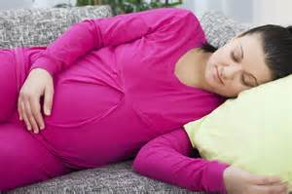
Get Some Zzzzz’s
You will experience fatigue during the first and third trimester. Don’t ignore the urge to rest during the day. Your body is doing some pretty amazing things and needs the nap to rejuvenate.
If your nose is stuffy and you are coughing when you lay down try propping yourself up and sleep in a sitting position.
When your baby gets bigger your belly will need some support. Tuck a pillow under your tummy while lying on your side.
Some other helpful tips:
Avoid caffeine
Avoid TV and computer screens an hour before bed.
Read in bed
Make sure it’s not too hot in your bedroom
Avoid foods that will cause heartburn
Meditate with picture imagery.
weteachfacs.com

Slide 31
Health During Pregnancy
Mothers-to-Be Daily Routines:
Eat a well-balanced diet
Exercise moderately
Get plenty of sleep
Practice good hygiene
Manage Stress
Manage Emotional Adjustments
Avoid depression

