Slide 1
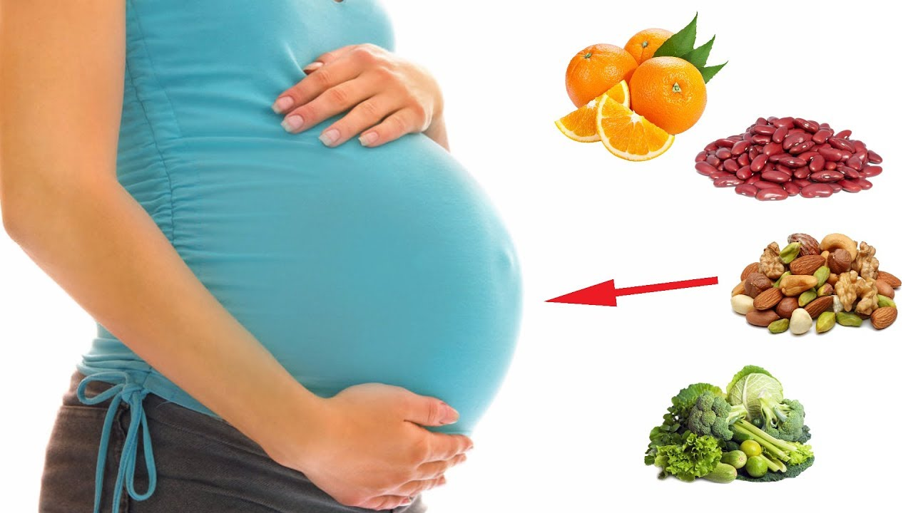
Prenatal Nutrition
Notes:
1

Slide 2
Why is This Relevant to Me?
Everyone knows someone who is pregnant/going to become pregnant
Diet and Exercise are important for people who are not pregnant.
Health problems are on the rise
Notes:
2

Slide 3
The History of Pregnancy Weight
During depression women didn’t have much food, smaller babies, easier deliveries.
In the 1950’s thru early 70’s women were advised to gain only 10-15 pounds.
1960’s President Kennedy commissioned the Task Force on Mental Retardation.
They found that low birth weight & prematurity were major factors in infant mortality (death) and morbidity (disease)
Poor weight gain in the 3rd trimester increases risks of
Neurological deficits
Mental retardation
Learning disabilities
Inadequate growth
weteachfacs.com

Slide 4
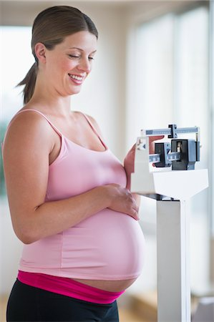
Weight Gain During Pregnancy
Healthy Pregnancy- gain 25 to 35 lbs if normal weight
Recommended weight gain:
Months 1st – 3rd: one pound per month
Months 4th – 9th: three to four pounds per month
Gaining too little weight = increase risk of fetal death or premature birth.
Gaining too much weight = added stress on the mother’s body and increase risk of complications.
Notes:
Some associated risks have been found between pre-pregnancy BMI and birth outcomes. Underweight women have complications such as an increased risk of preterm delivery, low birth weight, iron deficiency anemia, and other nutritional deficiencies associated with an inadequate diet. For overweight women, some risks include gestational diabetes, gestational hypertension (high blood pressure), Cesarean delivery, birth defects such as neural tube defects and even fetal death. Postpartum effects include hemorrhaging, wound infection or increased time of wound repair, and depression. If a women is obese during pregnancy, it also raises the chance her child will be obese later in life.

Slide 5
Weight Gain During Pregnancy
Weight gain depends on many factors:
Rate of weight gain
Maternal age
Appetite
Pre-pregnancy body mass index
Where the weight goes?
Baby-7.5 lbs
Breast growth- 2lbs
Maternal stores- 7lbs
Placenta 1.5 lbs
Uterus growth- 2lbs
Amniotic fluid- 2 lbs
Blood – 4 lbs
Body fluids- 4 lbs
Notes:
There has been much debate on the proper weight gain during pregnancy. Weight gain depends on many factors including the pre-pregnancy BMI. If BMI before pregnancy is low, a greater weight gain during the pregnancy is recommended. For example, if BMI is less than 19.8 the recommended weight gain is between 28-40 pounds. On the other hand, if BMI is above 29, the recommended weight gain is a minimum of 15 lbs.
The minimum of 15 pounds is based on the need to gain support tissues for the baby. An estimate of where the weight gain occurs in an average woman includes: the Baby 7 ½ pounds; breast tissue 2 pounds; Maternal stores (mainly protein and fat) 7 pounds; Placenta 1 ½ pound; uterus growth 2 pounds; Amniotic fluid (the water around the baby) 2 pounds; additional maternal blood 4 pounds; other body fluids 4 pounds.
To fully understand weight gain recommendations, it is important to define terms. BMI is the abbreviation for Body Mass Index. This is a measure of body fat based on height and weight. To calculate, divide weight in pounds by height in inches squared and multiply by 703. BMI calculation is the same for males and females. The normal range for BMI is 18.5-24.9. A BMI less than 18.5 is considered underweight, and this can have many implications on the mother and fetus, as discussed later. A BMI between 25 and 30 is overweight, and higher than 30 is considered obese.
5

Slide 6
Effects of underweight & overweight
Underweight (BMI <18.5)
Increased risk of preterm delivery
Low birth weight baby
Iron deficiency anemia
Nutritional requirements low
Overweight (BMI ≥25)
Gestational diabetes
Gestational hypertension
C-Section Delivery
Birth defects (neural tube defects)
Fetal death or miscarriage
Postpartum effects (hemorrhage, wound infection, depression)
Increase chance of childhood obesity
Notes:
6

Slide 7
Weight Gain During Pregnancy
Avoid weight loss during pregnancy even if obese
Weight gain during the 2nd trimester predicts birth weight
Seek proper weight before pregnancy
Weight should be gained gradually
First trimester
1-4 lbs total during the first 3 months
Second & Third Trimester
2 to 4 pounds per month during the 4th to 9th months
Most weight gained in last three months

Slide 8
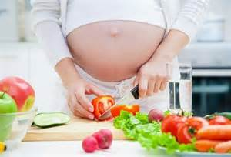
Eating Healthy
Baby needs calories and nutrients
to build heart, lungs, brain and skeleton.
You are not eating for two,
but you are sharing what you normally eat with your baby.
Make time for breakfast.
Avoid snacks with no nutrients; soda, coffee, chips, cakes and cookies.
Avoid fruit juice loaded with sugar. Eat fresh fruit instead.
Eat smaller portions several times per day.
Good choices at fast food restaurants include:
Grilled chicken, not fried
Baked potato, not French fries
Salad or fruit, not cookies
Milk or low fat yogurt, not milk shakes
weteachfacs.com

Slide 9
Dietary Guidelines for Non-Pregnant Individuals
Based on 2,000 calorie diet
Fruit Group
2 cups (4 servings)
Vegetable Group
2.5 cups (5 servings)
Grain Group
6 ounces
Meat and Beans Group
5.5 ounces
Milk Group
3 cups
Oils
24 grams (6tsp)
Notes:
This slide lists the dietary guidelines for non-pregnant individuals. These recommendations are the same for pregnant individuals with the exception of the small increase in calories for the 2nd and 3rd trimesters. During pregnancy, there will also be an increase in certain nutrients necessary for the growth and development of the baby, which will be discussed later. These guidelines were published in 2005 by the USDA but the updated version will be released later this year. The recommendations are based on a 2,000 calorie diet. For fruits, two cups or four servings of fruits/day are required. 5 servings or 2.5 cups of vegetables are required, while 6 ounces of grains are needed. For meat and beans, 5.5 ounces is required and 3 cups of milk. The dietary guidelines for oils states that 24 grams or roughly 6 teaspoons are required. Fats and sweets should be limited in the diet.

Slide 10
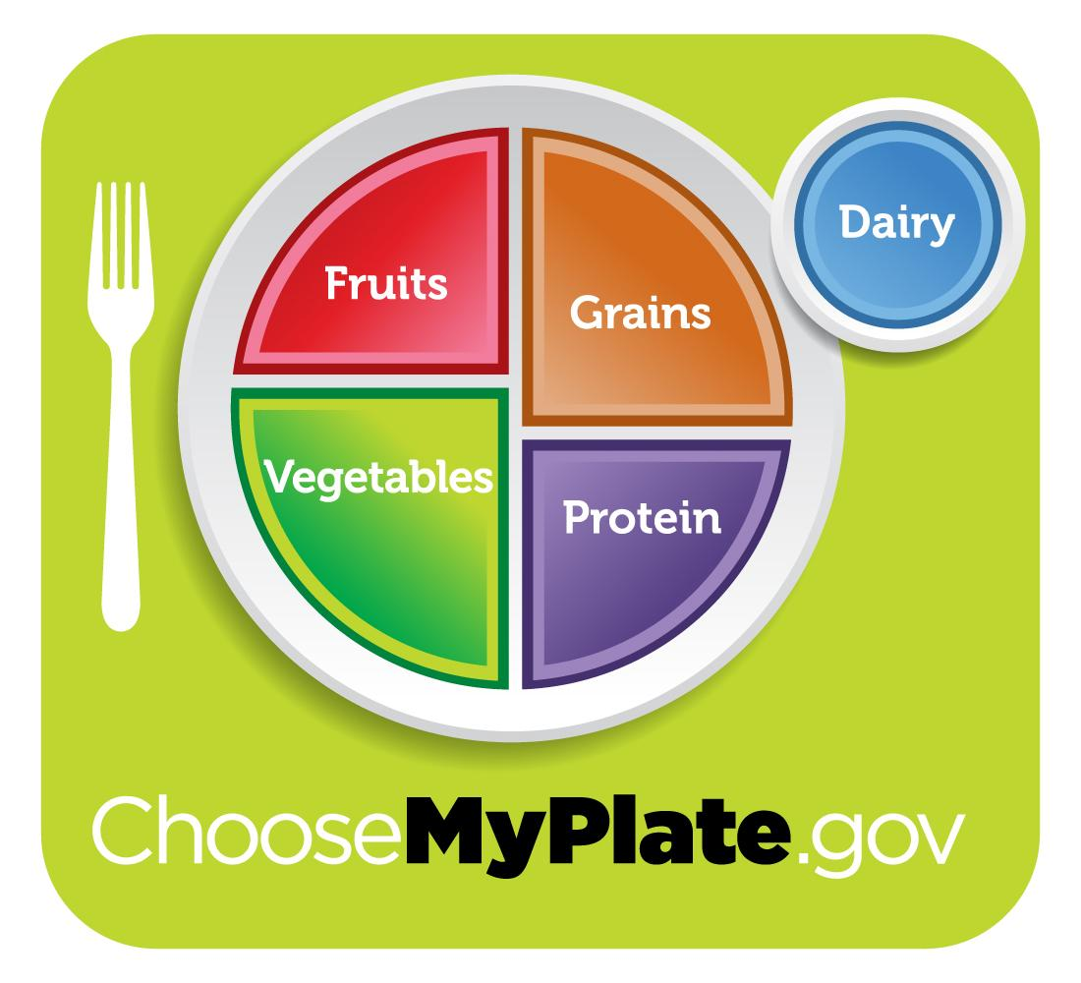
Nutrition During Pregnancy
Most pregnant women need 2,200-2,900 calories
Energy Requirements
No different than non- pregnant women until the 2nd trimester
340 kcal in the 2nd trimester
452 kcal in the 3rd trimester
Variety of foods
Choose nutrient-dense foods/ limit energy-dense foods
www.choosemyplate.gov
Notes:
There are many misconceptions about caloric needs during pregnancy. During early pregnancy the energy requirements are not different from pre-pregnancy needs. Typically, pregnant women require between 2,200-2,900 calories a day. This amount is sufficient for the additional needs of the developing fetus. A modest increase in calorie needs occurs during the second and third trimesters of pregnancy. During the second trimester there should be an increase of about 340 kcal per day and during the 3rd trimesters there should be an increase in 452 kcal per day. These are very minor increases in caloric intake. The main goal during pregnancy is to eat a variety of foods, especially fruits, vegetables and meats. Different foods contain different amounts of nutrients such as proteins, carbohydrates, vitamins, and minerals. The website www.mypryramid.gov provides much information on specific foods for healthy pregnancy. This website provides links to create individualized plans that are based on age, height, and weight to track and record food intake. Because of the special needs during pregnancy, using a website such as mypyramid.gov can be beneficial to ensure healthy eating.
10

Slide 11
How much is that increase?
452 Calories
2 oz turkey burger, 1/4 cup avocado, 1/4 cup grilled onions on one slice whole-grain bread (240 cals)
1/2 whole grain English muffin, toasted; 2 tbs pizza sauce, 2 oz low-fat mozzarella (190 cals)
340 Calories
8oz low-fat plain yogurt mixed with 1/2 cup raspberries and 1 tbs honey (205 cals)
One hard-boiled egg with a slice whole grain toast (130 cals)

Slide 12
Nutrition During Pregnancy
Whole grains
Bread, cereals, pasta, brown rice
Whole/Canned/Frozen Fruits
Apples, pears, peaches, nectarines, melon
Stay away from acidic fruits such as oranges, pineapples, lemons, and limes
Vegetables
Leafy greens, bell pepper, eggplant, squash, and mushrooms
Lean protein from plant and animal sources
Tofu, nuts, seeds, lentils, beans, red meat, chicken, turkey, fish and pork
Low-fat dairy
Milk, cheese and yogurt
Healthful fats
Canola oil, walnuts, almonds, avocados, and fish
Notes:
Some general recommendations for a healthy diet during pregnancy include: try whole grain instead of items made from white flour. These include breads, cereals, pastas and brown rice.
Whole fruits are advised but frozen or canned can be just as nutritious. If you opt for canned fruits avoid those canned in heavy syrup because they contain extra sugar. Fruits such as apples, pears, peaches, nectarines and melon are excellent choices. Because acid can cause heartburn, you may want to be cautious with the amount of acidic fruit you eat, like oranges, pineapples, lemons and limes. However, it these do not affect you there is no reason to avoid them in the diet.
Consume vegetables such as leafy greens, bell peppers, eggplant, squash and mushrooms.
Lean protein from both plant-based and animal-based sources is recommended: Try tofu, nuts, seeds, lentils, beans, red meat, chicken, turkey, fish and pork.
Low-fat dairy: Milk, cheese and yogurt. Try to stick to low fat or fat free dairy sources
Healthful fats: such as canola oil, walnuts, almonds and avocadoes. These contain omega-3 fatty acids which are essential – meaning the body cannot make them so they must be supplied from the diet. Omega-3 fatty acids decrease cardiovascular disease and improve heart and blood vessel function. During pregnancy, omega-3 fatty acids are also important in brain development of the fetus.
12

Slide 13
Foods to Avoid During Pregnancy
Minimize beverages/sports drinks or foods with:
High sugar content
High Sodium
Raw Eggs
Unpasteurized juices or dairy products
Undercooked meat, poultry, and fish
Deli meats
Raw vegetable sprouts
Soft Cheeses
Fish
Notes:
There are some foods to avoid during pregnancy. These include beverages or sports drinks and foods containing a high amounts of sugar and/or sodium. High sodium intake may lead to increased blood pressure, and high sugar foods add calories without nutritional value. Several foods that increase risk of foodborne illness should also be avoided including, raw or undercooked eggs which may carry salmonella, unpasteurized juices or dairy products, undercooked meat, poultry and fish, and deli meats which may contain Listeria which is of particular concern for pregnant women. In addition, raw vegetable sprouts can contain E. Coli or Salmonella and soft cheeses such as Queso Fresco that have not been pasteurized may also contain pathogenic bacteria. Food borne illnesses during pregnancy may be more severe than in non-pregnant individuals and may affect the fetus. Fish consumption may also need to be moderated to avoid mercury contamination. This brings me to my next point.
13

Slide 14
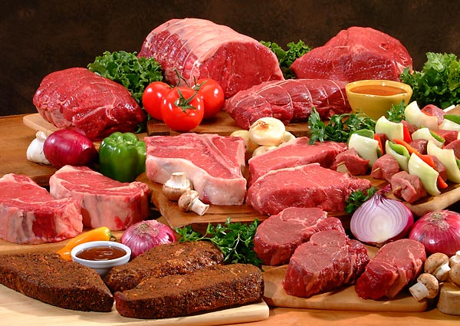
Potential Pathogen/Food Safety
Pathogens:
Listeria
Airborne pathogen
Can grow at refrigeration temperatures
Deli meats, unpasteurized milk, refrigerated and ready to eat products
Increase risk of miscarriage, stillbirth, and preterm birth
Toxoplasma gondii
Can pass through placenta
Feces of cats
Contaminated/undercooked meat, unwashed fruits, unpasteurized milk, contaminated water
Food safety tips:
Wash fruits and vegetables
Heat meat to steaming
Notes:
Potential pathogens in food include Listeria, which is an airborne bacteria that can grow at refrigeration temperatures. Listeriosis can affect the fetus and cause spontaneous abortions. It can be found in deli meats and unpasteurized milk. Hence, consuming these foods is not recommended during pregnancy. Toxoplasma gondii is the other pathogen that can exist in food. Toxoplasma gondii can pass through the placenta, therefore infecting the fetus. Toxoplasma gondii is common in house cats and therefore it is advised that pregnant women avoid feces of cats and wash their hands thoroughly after being around cat feces. It can also be found in contaminated/undercooked meat, unwashed fruits, unpasteurized milk, and contaminated water. Good food safety practices are important for the health of the mother and fetus during pregnancy. Always store food properly, cook to recommended temperatures, avoid cross-contaminations and properly clean surfaces and utensils.
14

Slide 15
Mercury
Controversial topic
Tuna
No more than twice per week
High amount of mercury in large predatory fish (<100g per week)
King Mackerel
Pike
Shark
Walleye
Barracuda
Large Tuna
Notes:
15

Slide 16
PICA
PICA
Ingestion of non-food items
Dirt.clay. paint chips. Plaster. chalk.
Cornstarch. laundry starch. baking soda.
Associated with Iron deficiency
Cravings for taste, smell, or texture
Complications
Depend on substance eaten
GI disturbance
Excess weight gain
Hyperglycemia
High Blood Pressure
Metabolic Alkalosis
Notes:
16

Slide 17
Nutrition And Pregnant Teens
Teens’ bodies have special nutritional needs because the are still developing.
Essential for a teen’s own body and her growing baby to get all the nutrients for proper growth and development.
Nutrients important for pregnant teens:
Calcium- essential for growing bones.
Iron- helps carry blood to all parts of the body.

Slide 18
Special Diets- Lactose Intolerant
Lactose- type of sugar found in milk.
Lactose Intolerant- not able to digest lactose.
Symptoms: if milk products cause symptoms such as abdominal pain and gas.
Lactase- an enzyme that helps digest lactose.
Eating foods with lactase, such as yogurt, helps some people digest milk.

Slide 19
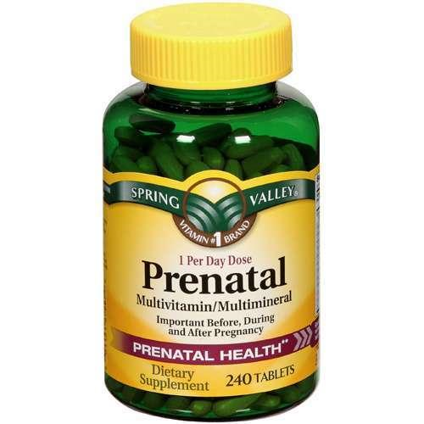
Supplementation
Prenatal multivitamin is advised before pregnancy for
Women with multiple births
Women with HIV
Women taking drugs
Women eating little/no animal products
Multivitamin used to complement,
not to substitute for a good diet
Early supplementation has shown to decrease risk for preeclampsia
Notes:
19

Slide 20
Nutrients In Pregnancy
Vit. C- build healthy teeth and gums; helps form connective tissue of skin, bone, and organs.
Citrus fruits- oranges
Vit. D- aids in the creation of bones and teeth.
Milk and other milk products
Iron- prevent anemia and assists in developing the baby’s own blood supply.
Dried beans, raisins, dates, meat, leafy greens
Calcium & Phosphorus- work together to produce strong bones and teeth. Also to ensure regular elimination of waste from the body.
Milk and other dairy products

Slide 21
Nutrients In Pregnancy
Protein- vital to baby’s growth and development of bones and teeth. Also, keeps mom healthy.
EX: meat, poultry, fish, dry beans, nuts, eggs, tofu
Folic Acid- normal spinal development in fetus. Mothers need twice the normal amount.
Dark leafy greens (spinach, romaine lettuce), broccoli
Vit. A- ensures proper eye development and healthy skin.
Orange vegetables- carrots, summer squash
Vit. B- general fetal development.
grains

Slide 22
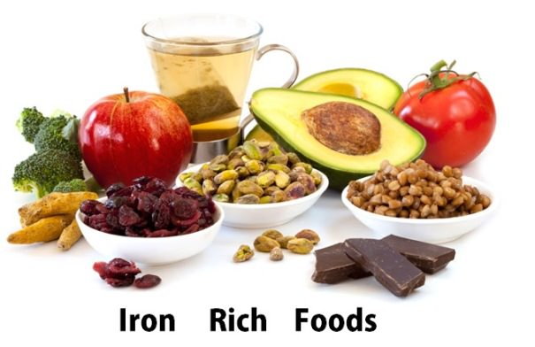
Iron
Pregnant women are at high risk for anemia
Iron deficiency
Helps red blood cells deliver oxygen to the baby
Non-pregnant women: 15-18 milligrams/day
Pregnant women 27 milligrams/day
Sources: Spinach, kale, leafy greens, beans, fortified cereals, red meat, chicken, fish, liver
Notes:
Maternal anemia due to iron deficiency is a common pregnancy risk. Iron is essential for red blood cells to deliver oxygen to the baby during pregnancy. And during pregnancy, increased blood cells are needed to meet the needs of the growing fetus. Studies have shown that iron intake by non-pregnant women is often inadequate, therefore increasing iron intake before pregnancy is necessary. Pregnant women need at least 27 milligrams of iron a day, which is higher than the 15-18 mg needed by non-pregnancy women. Iron is most available from red meats and chicken. Plant sources of iron include spinach, kale, leafy greens, beans, and fortified cereals. However, the iron in these foods is poorly absorbed. Therefore, vegetarians and women who do not eat meat, should increase iron absorption by combining plant-based sources of iron with vitamin C-rich foods. For example, try spinach salad with mandarin oranges or cereal with strawberries. And in many cases, an iron supplement is necessary to ensure meeting the requirement for this important nutrient.
22

Slide 23
Omega 3-Fatty Acids/DHA
Essential fatty acids
Needs to come from diet
Body cannot make them
Child growth, development, & health
Visual & Cognitive Development
Present in breast milk
200 milligrams/day
Sources
Fish
Fish oil
Canola Oil
Flax
Notes:
23

Slide 24
Calcium & Vitamin D
Calcium
Development of baby’s teeth, bones, heart, nerves, and muscles
1,000 milligrams/day Calcium before and during pregnancy
Sources
Low-fat or fat-free milk
Yogurt
Cheese
Calcium-fortified cereals
Calcium-fortified juices
Vitamin D
Reduce infection in pregnancy
Reduce preeclampsia
Increase absorption of Calcium
Notes:
During pregnancy, calcium is needed for the development of the baby’s teeth, bones, heart, nerves and muscles. When a pregnant woman does not consume enough calcium, it is removed from her bones for the baby. Therefore, it is important to consume 1,000 milligrams of calcium a day before, during and after pregnancy. That means at least three daily servings of calcium-rich foods such as low-fat or fat-free milk, yogurt or cheese or calcium-fortified cereals and juices. If you choose to get your calcium from fortified juices, avoid those with high sugar content. Vitamin D is important for the absorption of calcium. Without vitamin D, calcium isn’t absorbed as readily into the body. Vitamin D can come from two sources - the diet and the sun. Vitamin D can be synthesized in the skin exposed to sunlight, and only 10-15 minutes of exposure per day is needed to maintain Vitamin D levels. However, the ability to make vitamin D is influenced by skin color and genetics, as well as the angle of the sun. In northern climates, sun exposure is not sufficient in the fall, winter or spring to maintain vitamin D levels, therefore it is especially important to consume foods rich in Vitamin D during these months. The discovery of multiple functions of vitamin D that are important for growth and development, including regulation of cellular differentiation and apoptosis, preeclampsia, immune system development, and brain development, has led to increased interest in the role of this vitamin during pregnancy.

Slide 25
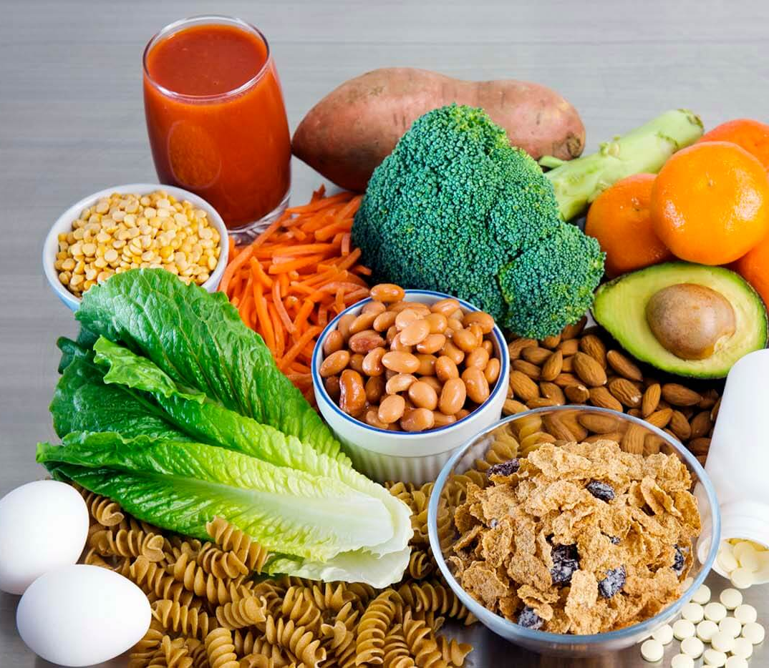
Folic Acid also known as Folate
Reduces risk of birth defects affecting the spinal cord
Needed to produce blood and protein for the baby.
Advised to increase intake when planning or in childbearing years.
400 micrograms/day for non-pregnant women
600 micrograms/day for pregnant women
Fortified Sources
Cereals
Pasta
Bread
Notes:
Folic acid reduces the risk of birth defects that affect the spinal cord. It is also needed to produce blood and protein for the baby. Unfortunately, most women have low intake of folate and therefore risk folate related problems during pregnancy. For this reason, women are advised to increase folic acid in the diet before they become pregnant. This may be difficult because many women have unplanned pregnancies. Therefore, it is crucial to increase intake when planning or capable of becoming pregnant. For most women, starting folate supplementation 1 month before pregnancy is sufficient to ensure adequate folate levels before pregnancy. Pregnant women need 600 micrograms of folic acid a day which is 200 micrograms/day more than non-pregnant women. Sources of folic acid include fortified foods like cereals, pastas, and breads, and green vegetables. For many women, food sources alone are not sufficient to meet folate needs, therefore supplementation is advised. All women of childbearing age should consume at least 400 micrograms of folic acid each day.

Slide 26
Folic Acid Fortification and Neural Birth Defects
Introduction - research by March of Dimes
Mandatory fortification
Increase by 30–70% of folic acid
87% due to Spina Bifida
Results
Before fortification
Neural tube defects was 1.85 per 1000 live births
Introduction of fortification
Neural tube defects was 1.07 per 1000 live birth
After fortification
Neural tube defects was .95 per 1000 live births
Conclusion
Significant decline of 49% in incidence of neural tube defects

Slide 27
Folate
Reduces risk of birth defects affecting the spinal cord
Needed to produce blood and protein for the baby.
Advised to increase intake when planning or capable of pregnancy.
400 micrograms/day for non-pregnant women
600 micrograms/day for pregnant women
Sources
Cereals
Pasta
Bread
Supplements
Notes:
Folic acid reduces the risk of birth defects that affect the spinal cord. It is also needed to produce blood and protein for the baby. Unfortunately, most women have low intake of folate and therefore risk folate related problems during pregnancy. For this reason, women are advised to increase folic acid in the diet before they become pregnant. This may be difficult because many women have unplanned pregnancies. Therefore, it is crucial to increase intake when planning or capable of becoming pregnant. For most women, starting folate supplementation 1 month before pregnancy is sufficient to ensure adequate folate levels before pregnancy. Pregnant women need 600 micrograms of folic acid a day which is 200 micrograms/day more than non-pregnant women. Sources of folic acid include fortified foods like cereals, pastas, and breads, and green vegetables. For many women, food sources alone are not sufficient to meet folate needs, therefore supplementation is advised. All women of childbearing age should consume at least 400 micrograms of folic acid each day.

Slide 28
Folate
Reduces risk of birth defects affecting the spinal cord
Needed to produce blood and protein for the baby.
Advised to increase intake when planning or capable of pregnancy.
400 micrograms/day for non-pregnant women
600 micrograms/day for pregnant women
Sources
Cereals
Pasta
Bread
Supplements
Notes:
Folic acid reduces the risk of birth defects that affect the spinal cord. It is also needed to produce blood and protein for the baby. Unfortunately, most women have low intake of folate and therefore risk folate related problems during pregnancy. For this reason, women are advised to increase folic acid in the diet before they become pregnant. This may be difficult because many women have unplanned pregnancies. Therefore, it is crucial to increase intake when planning or capable of becoming pregnant. For most women, starting folate supplementation 1 month before pregnancy is sufficient to ensure adequate folate levels before pregnancy. Pregnant women need 600 micrograms of folic acid a day which is 200 micrograms/day more than non-pregnant women. Sources of folic acid include fortified foods like cereals, pastas, and breads, and green vegetables. For many women, food sources alone are not sufficient to meet folate needs, therefore supplementation is advised. All women of childbearing age should consume at least 400 micrograms of folic acid each day.

Slide 29
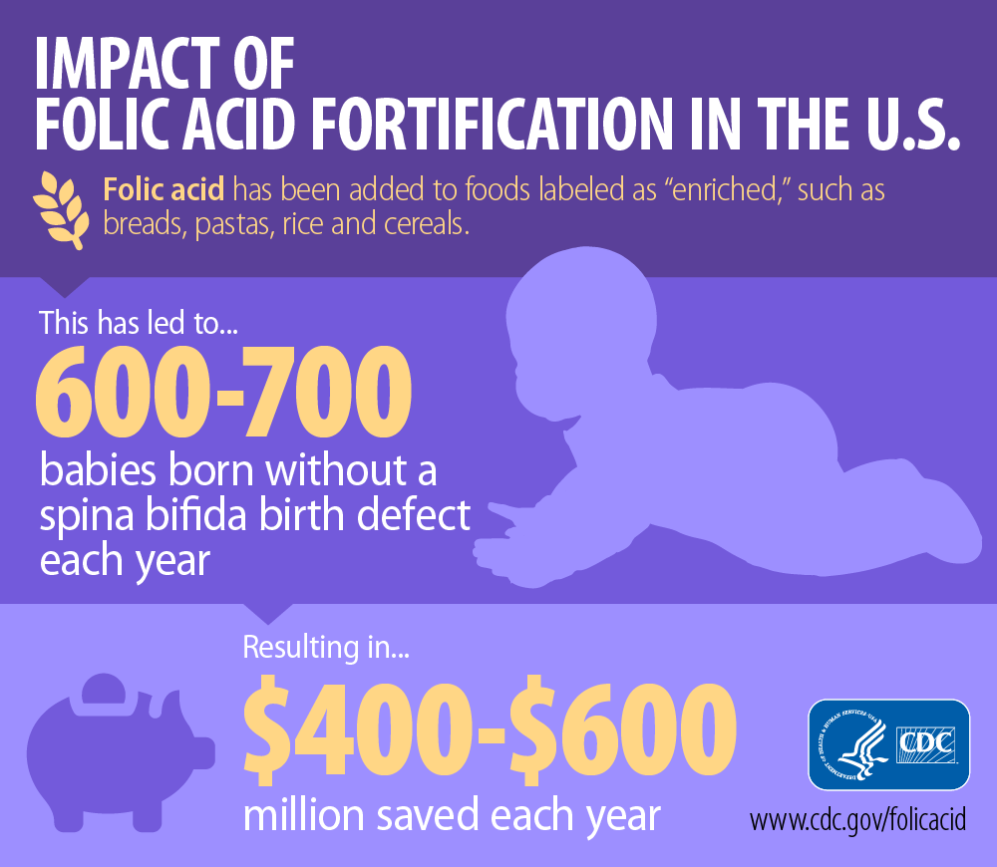
Folate
Reduces risk of birth defects affecting the spinal cord
Needed to produce blood and protein for the baby.
Advised to increase intake when planning or capable of pregnancy.
400 micrograms/day for non-pregnant women
600 micrograms/day for pregnant women
Sources
Cereals
Pasta
Bread
Supplements
Notes:
Folic acid reduces the risk of birth defects that affect the spinal cord. It is also needed to produce blood and protein for the baby. Unfortunately, most women have low intake of folate and therefore risk folate related problems during pregnancy. For this reason, women are advised to increase folic acid in the diet before they become pregnant. This may be difficult because many women have unplanned pregnancies. Therefore, it is crucial to increase intake when planning or capable of becoming pregnant. For most women, starting folate supplementation 1 month before pregnancy is sufficient to ensure adequate folate levels before pregnancy. Pregnant women need 600 micrograms of folic acid a day which is 200 micrograms/day more than non-pregnant women. Sources of folic acid include fortified foods like cereals, pastas, and breads, and green vegetables. For many women, food sources alone are not sufficient to meet folate needs, therefore supplementation is advised. All women of childbearing age should consume at least 400 micrograms of folic acid each day.

Slide 30
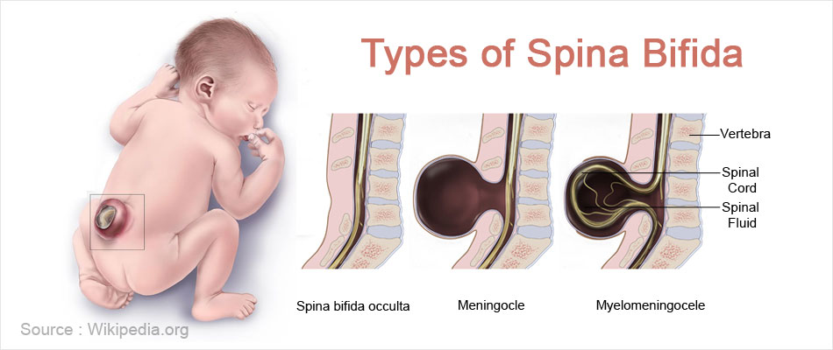
Folate
Reduces risk of birth defects affecting the spinal cord
Needed to produce blood and protein for the baby.
Advised to increase intake when planning or capable of pregnancy.
400 micrograms/day for non-pregnant women
600 micrograms/day for pregnant women
Sources
Cereals
Pasta
Bread
Supplements
Notes:
Folic acid reduces the risk of birth defects that affect the spinal cord. It is also needed to produce blood and protein for the baby. Unfortunately, most women have low intake of folate and therefore risk folate related problems during pregnancy. For this reason, women are advised to increase folic acid in the diet before they become pregnant. This may be difficult because many women have unplanned pregnancies. Therefore, it is crucial to increase intake when planning or capable of becoming pregnant. For most women, starting folate supplementation 1 month before pregnancy is sufficient to ensure adequate folate levels before pregnancy. Pregnant women need 600 micrograms of folic acid a day which is 200 micrograms/day more than non-pregnant women. Sources of folic acid include fortified foods like cereals, pastas, and breads, and green vegetables. For many women, food sources alone are not sufficient to meet folate needs, therefore supplementation is advised. All women of childbearing age should consume at least 400 micrograms of folic acid each day.

Slide 31
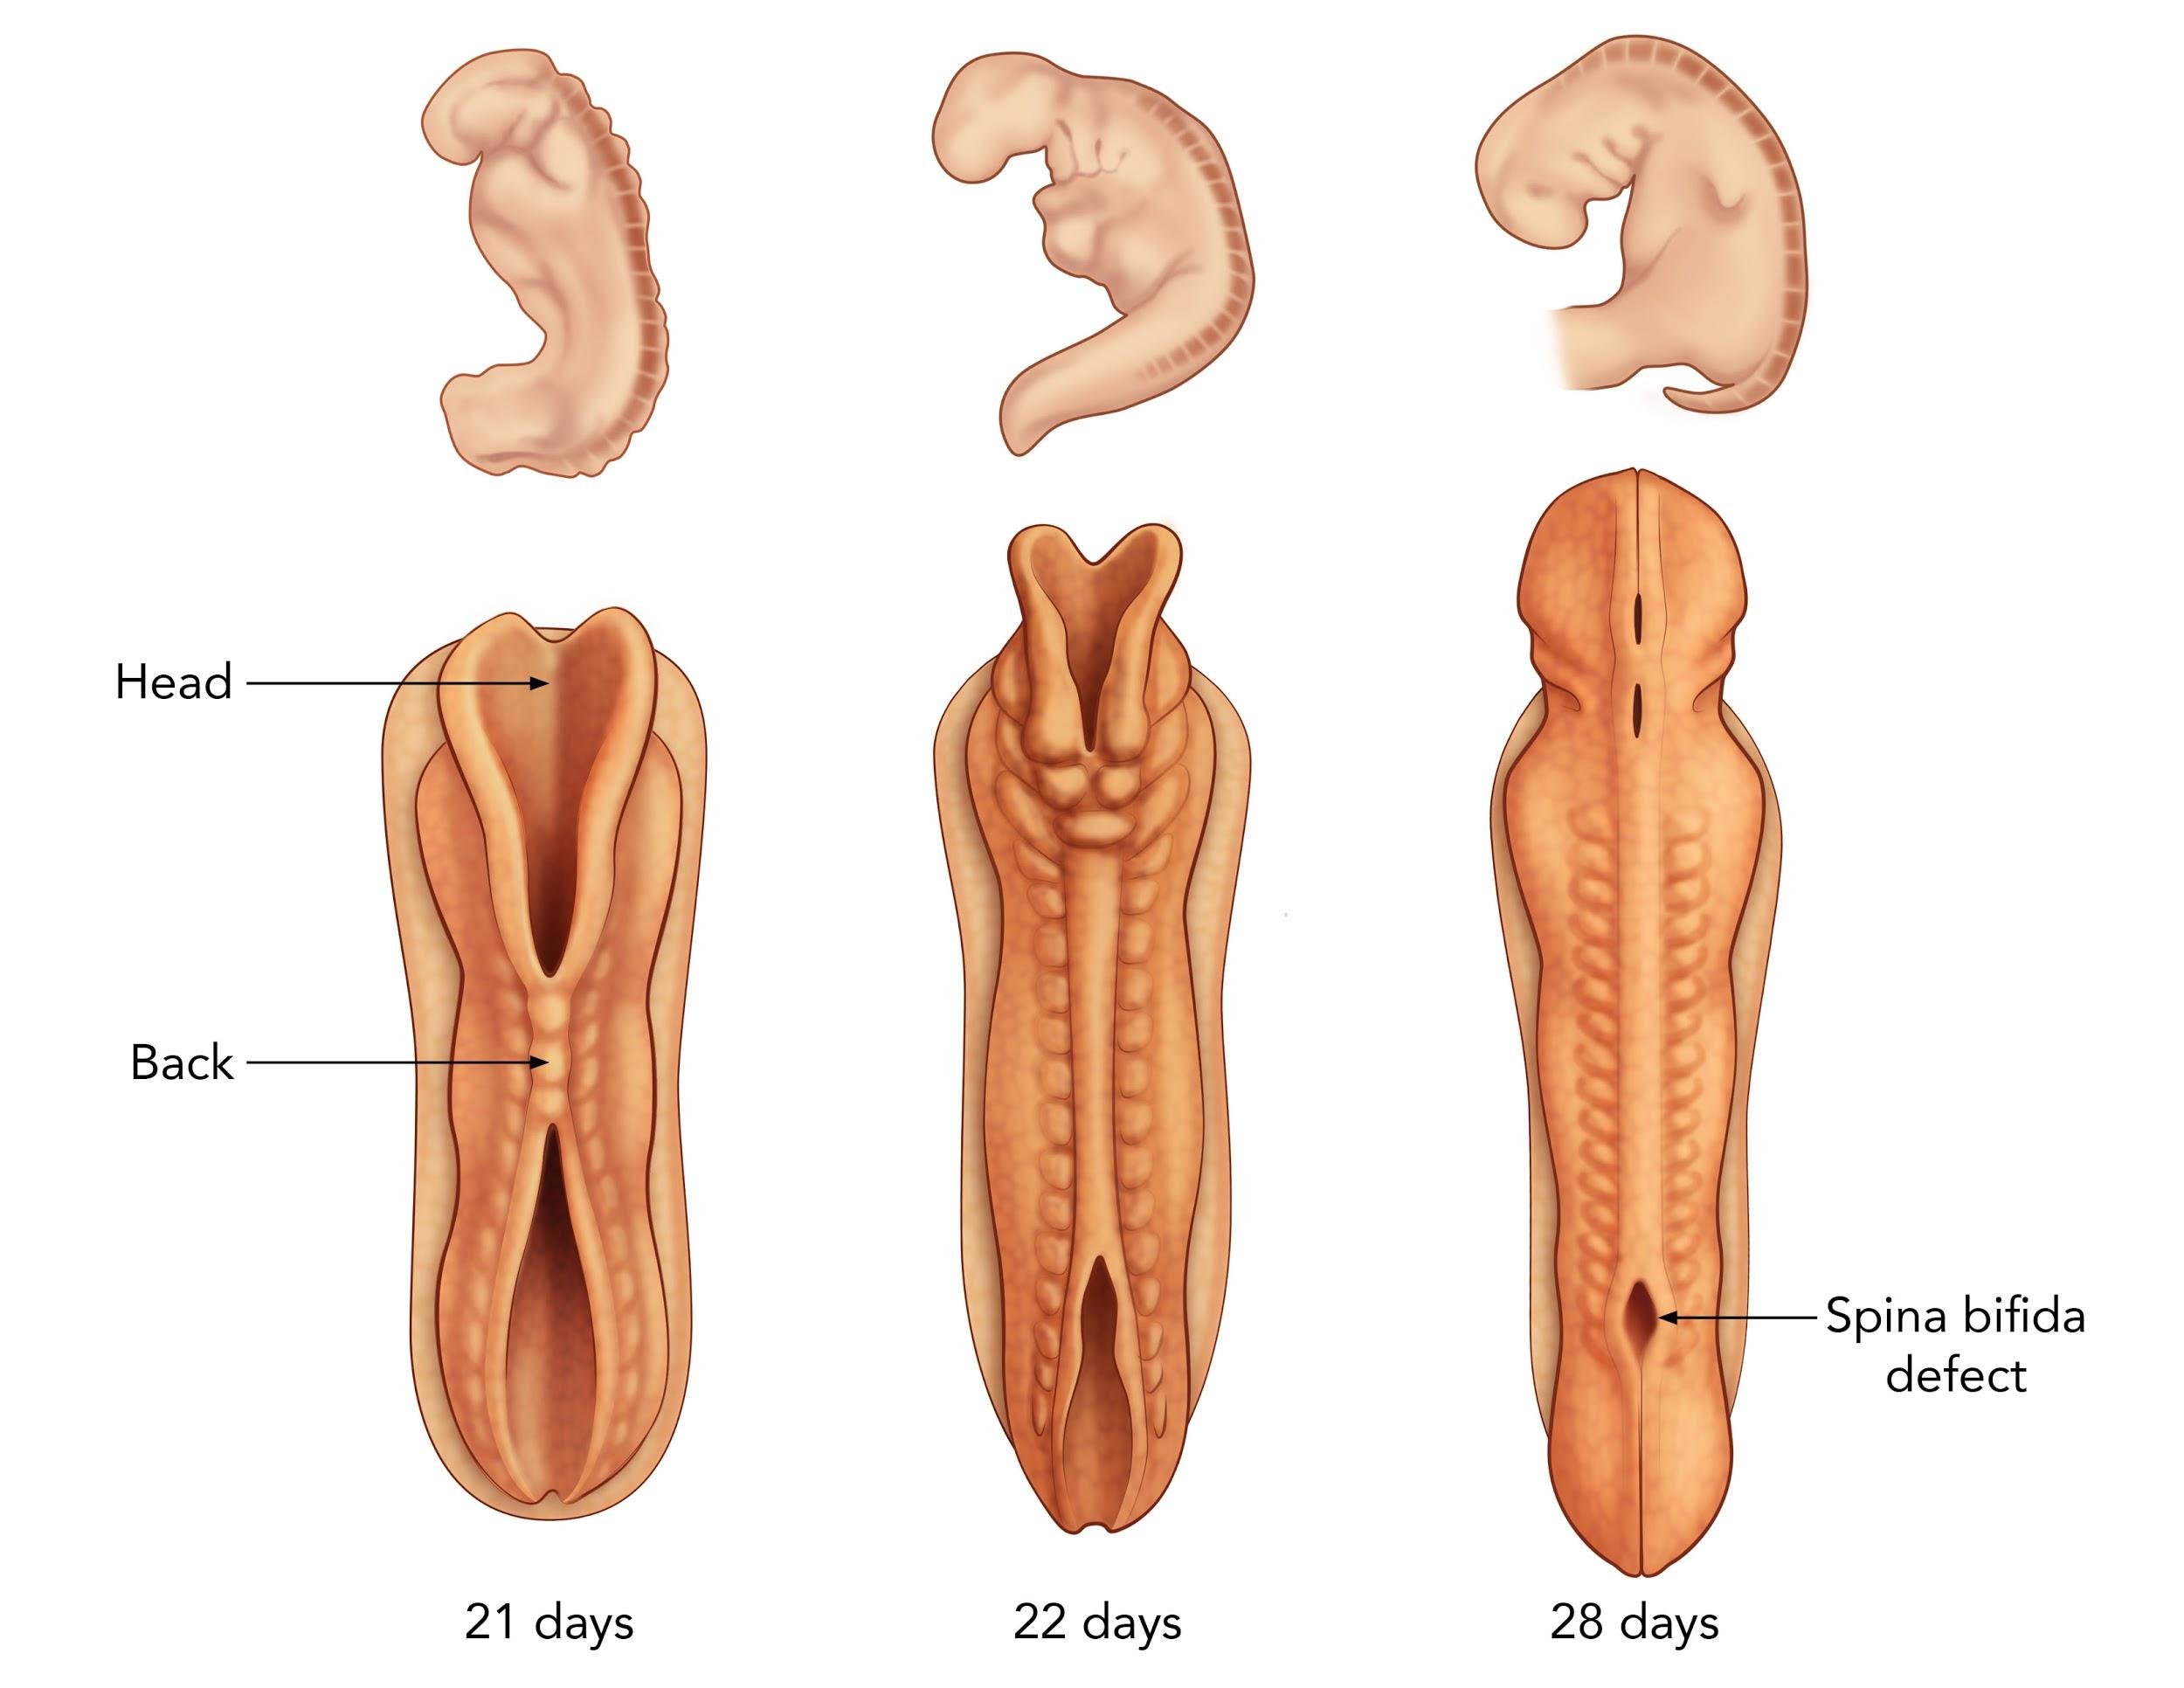
Folate
Reduces risk of birth defects affecting the spinal cord
Needed to produce blood and protein for the baby.
Advised to increase intake when planning or capable of pregnancy.
400 micrograms/day for non-pregnant women
600 micrograms/day for pregnant women
Sources
Cereals
Pasta
Bread
Supplements
Notes:
Folic acid reduces the risk of birth defects that affect the spinal cord. It is also needed to produce blood and protein for the baby. Unfortunately, most women have low intake of folate and therefore risk folate related problems during pregnancy. For this reason, women are advised to increase folic acid in the diet before they become pregnant. This may be difficult because many women have unplanned pregnancies. Therefore, it is crucial to increase intake when planning or capable of becoming pregnant. For most women, starting folate supplementation 1 month before pregnancy is sufficient to ensure adequate folate levels before pregnancy. Pregnant women need 600 micrograms of folic acid a day which is 200 micrograms/day more than non-pregnant women. Sources of folic acid include fortified foods like cereals, pastas, and breads, and green vegetables. For many women, food sources alone are not sufficient to meet folate needs, therefore supplementation is advised. All women of childbearing age should consume at least 400 micrograms of folic acid each day.

Slide 32
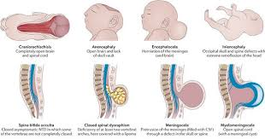
Folate
Reduces risk of birth defects affecting the spinal cord
Needed to produce blood and protein for the baby.
Advised to increase intake when planning or capable of pregnancy.
400 micrograms/day for non-pregnant women
600 micrograms/day for pregnant women
Sources
Cereals
Pasta
Bread
Supplements
Notes:
Folic acid reduces the risk of birth defects that affect the spinal cord. It is also needed to produce blood and protein for the baby. Unfortunately, most women have low intake of folate and therefore risk folate related problems during pregnancy. For this reason, women are advised to increase folic acid in the diet before they become pregnant. This may be difficult because many women have unplanned pregnancies. Therefore, it is crucial to increase intake when planning or capable of becoming pregnant. For most women, starting folate supplementation 1 month before pregnancy is sufficient to ensure adequate folate levels before pregnancy. Pregnant women need 600 micrograms of folic acid a day which is 200 micrograms/day more than non-pregnant women. Sources of folic acid include fortified foods like cereals, pastas, and breads, and green vegetables. For many women, food sources alone are not sufficient to meet folate needs, therefore supplementation is advised. All women of childbearing age should consume at least 400 micrograms of folic acid each day.

Slide 33
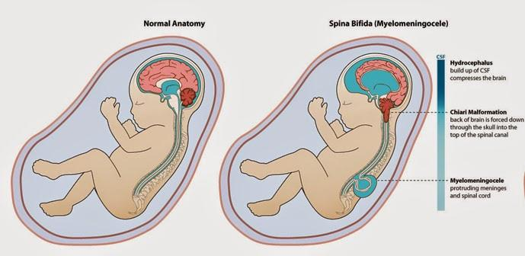
Folate
Reduces risk of birth defects affecting the spinal cord
Needed to produce blood and protein for the baby.
Advised to increase intake when planning or capable of pregnancy.
400 micrograms/day for non-pregnant women
600 micrograms/day for pregnant women
Sources
Cereals
Pasta
Bread
Supplements
Notes:
Folic acid reduces the risk of birth defects that affect the spinal cord. It is also needed to produce blood and protein for the baby. Unfortunately, most women have low intake of folate and therefore risk folate related problems during pregnancy. For this reason, women are advised to increase folic acid in the diet before they become pregnant. This may be difficult because many women have unplanned pregnancies. Therefore, it is crucial to increase intake when planning or capable of becoming pregnant. For most women, starting folate supplementation 1 month before pregnancy is sufficient to ensure adequate folate levels before pregnancy. Pregnant women need 600 micrograms of folic acid a day which is 200 micrograms/day more than non-pregnant women. Sources of folic acid include fortified foods like cereals, pastas, and breads, and green vegetables. For many women, food sources alone are not sufficient to meet folate needs, therefore supplementation is advised. All women of childbearing age should consume at least 400 micrograms of folic acid each day.

Slide 34
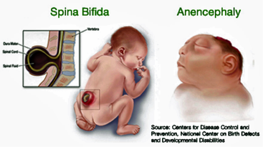
Folate
Reduces risk of birth defects affecting the spinal cord
Needed to produce blood and protein for the baby.
Advised to increase intake when planning or capable of pregnancy.
400 micrograms/day for non-pregnant women
600 micrograms/day for pregnant women
Sources
Cereals
Pasta
Bread
Supplements
Notes:
Folic acid reduces the risk of birth defects that affect the spinal cord. It is also needed to produce blood and protein for the baby. Unfortunately, most women have low intake of folate and therefore risk folate related problems during pregnancy. For this reason, women are advised to increase folic acid in the diet before they become pregnant. This may be difficult because many women have unplanned pregnancies. Therefore, it is crucial to increase intake when planning or capable of becoming pregnant. For most women, starting folate supplementation 1 month before pregnancy is sufficient to ensure adequate folate levels before pregnancy. Pregnant women need 600 micrograms of folic acid a day which is 200 micrograms/day more than non-pregnant women. Sources of folic acid include fortified foods like cereals, pastas, and breads, and green vegetables. For many women, food sources alone are not sufficient to meet folate needs, therefore supplementation is advised. All women of childbearing age should consume at least 400 micrograms of folic acid each day.

Slide 35
Folate
Reduces risk of birth defects affecting the spinal cord
Needed to produce blood and protein for the baby.
Advised to increase intake when planning or capable of pregnancy.
400 micrograms/day for non-pregnant women
600 micrograms/day for pregnant women
Sources
Cereals
Pasta
Bread
Supplements
Notes:
Folic acid reduces the risk of birth defects that affect the spinal cord. It is also needed to produce blood and protein for the baby. Unfortunately, most women have low intake of folate and therefore risk folate related problems during pregnancy. For this reason, women are advised to increase folic acid in the diet before they become pregnant. This may be difficult because many women have unplanned pregnancies. Therefore, it is crucial to increase intake when planning or capable of becoming pregnant. For most women, starting folate supplementation 1 month before pregnancy is sufficient to ensure adequate folate levels before pregnancy. Pregnant women need 600 micrograms of folic acid a day which is 200 micrograms/day more than non-pregnant women. Sources of folic acid include fortified foods like cereals, pastas, and breads, and green vegetables. For many women, food sources alone are not sufficient to meet folate needs, therefore supplementation is advised. All women of childbearing age should consume at least 400 micrograms of folic acid each day.

Slide 36
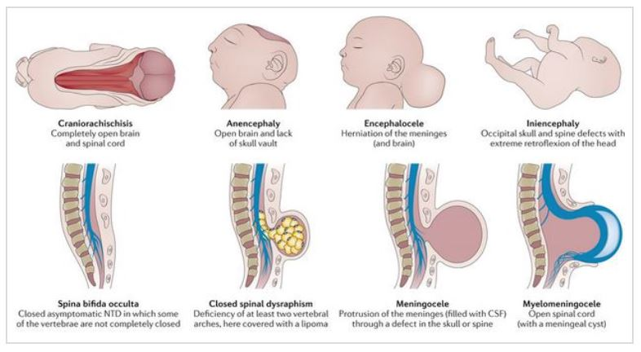
Folate
Reduces risk of birth defects affecting the spinal cord
Needed to produce blood and protein for the baby.
Advised to increase intake when planning or capable of pregnancy.
400 micrograms/day for non-pregnant women
600 micrograms/day for pregnant women
Sources
Cereals
Pasta
Bread
Supplements
Notes:
Folic acid reduces the risk of birth defects that affect the spinal cord. It is also needed to produce blood and protein for the baby. Unfortunately, most women have low intake of folate and therefore risk folate related problems during pregnancy. For this reason, women are advised to increase folic acid in the diet before they become pregnant. This may be difficult because many women have unplanned pregnancies. Therefore, it is crucial to increase intake when planning or capable of becoming pregnant. For most women, starting folate supplementation 1 month before pregnancy is sufficient to ensure adequate folate levels before pregnancy. Pregnant women need 600 micrograms of folic acid a day which is 200 micrograms/day more than non-pregnant women. Sources of folic acid include fortified foods like cereals, pastas, and breads, and green vegetables. For many women, food sources alone are not sufficient to meet folate needs, therefore supplementation is advised. All women of childbearing age should consume at least 400 micrograms of folic acid each day.

Slide 37
Notes:
In conclusion, proper weight gain during pregnancy is essential to maintaining the health and well being of both the mother and fetus. Modest, consistent weight gain is the goal. Nutrients such as iron, vitamin D, omega 3 fatty acids, and folic acid are important to supplement during pregnancy. Increased calorie intake of 340 and 452 kcals are recommended during the second and third trimesters. Exercise during pregnancy is beneficial not only for the mother but also for the fetus. The nutrition and exercise recommendations discussed in this presentation are important for pregnant women but can be maintained after pregnancy for a healthy lifestyle.

Slide 38
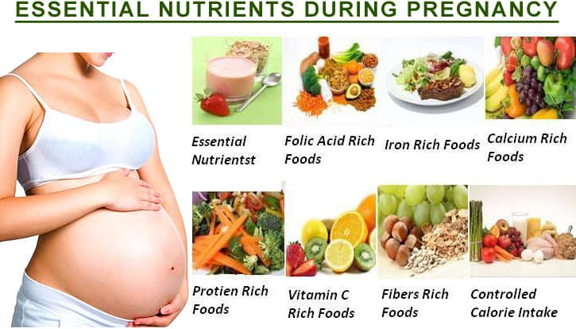
Dietary Guidelines for Pregnant Individuals

